Slide 1

Getting Your Small Business in Order
Essential Steps for First-time Entrepreneurs
Presented by: Louie Picazo, CFE

Slide 2

Agenda
Introduction
2. Establishing a Clear Business Plan
3. Financial Organization
4. Legal and Administrative Setup
5. Building a Strong Marketing Strategy
6. Streamlining Operations
7. Managing Human Resources
8. Evaluating and Improving Your Business
Conclusion

Slide 3


Introduction
Key Areas to Focus on:
Importance of organization in business success
Planning, Finance, Legal, Marketing, and Operations.

Slide 4
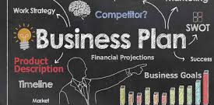
Establishing a Clear Business Plan
Define your business purpose and goals
Conduct Market Analysis
Set Strategic Objectives
Defining your business purpose and goals is a foundational step in establishing and growing your enterprise
Conducting a market analysis is a crucial step in understanding the environment your business operates within
Setting strategic business objectives involves defining clear, actionable targets that align with your overall vision and mission
Notes:
Defining your business purpose and goals is a foundational step in establishing and growing your enterprise. Here’s a step-by-step guide to help you articulate these critical elements:
### Step 1: Understand Your Business Purpose
1. **Identify Your Passion and Expertise:**
- Reflect on what you love doing and are skilled at. This will help shape your business idea.
. **Determine the Needs You’ll Meet:**
- Pinpoint the problem your business will solve or the need it will fulfill in the market.
3. **Clarify Your Mission:**
- Craft a mission statement that succinctly describes what your business aims to achieve.
- Example: "To provide high-quality, affordable eco-friendly products that help consumers reduce their environmental impact."
### Step 2: Define Your Business Goals
1. **Set SMART Goals:**
- Goals should be Specific, Measurable, Achievable, Relevant, and Time-bound.
- Example: "Increase online sales by 20% over the next six months."
2. **Differentiate Between Short-term and Long-term Goals:**
- **Short-term Goals:** Objectives to achieve within the next year (e.g., launching a new product line).
- **Long-term Goals:** Plans for the next 3-5 years, aligning with your vision for growth and expansion (e.g., becoming a leading regional provider).
3. **Align Goals with Business Values:**
- Ensure that your goals reflect your core values and your established mission statement.
4. **Consider Financial Goals:**
- Determine revenue targets, profitability benchmarks, and budgetary constraints.
5. **Incorporate Customer-related Goals:**
- Focus on customer satisfaction, retention, and engagement, which are vital for sustainable growth.
### Step 3: Review and Adjust
1. **Regularly Review Progress:**
- Set up periodic reviews (monthly, quarterly) to assess progress towards achieving your goals.
2. **Be Flexible and Adaptable:**
- As your business environment changes, be open to refining your goals to stay relevant and competitive.
Conducting a market analysis is a crucial step in understanding the environment your business operates within. Here’s a summary of the key components involved:
### 1. **Industry Overview**
- **Understand the Industry:** Examine the current state, trends, growth potential, and key players in your industry.
- **Identify Opportunities and Threats:** Look for emerging opportunities and potential threats to inform your strategy.
### 2. **Target Market Identification**
- **Define Your Audience:** Identify the demographics, needs, and preferences of your potential customers.
- **Segment the Market:** Break down the broad market into smaller segments to tailor your marketing strategies effectively.
### 3. **Competitive Analysis**
- **Identify Competitors:** List both direct and indirect competitors.
- **Evaluate Competitors’ Strengths and Weaknesses:** Understand what competitors offer and where they fall short.
- **Benchmarking:** Compare your business against competitors to find areas of improvement.
### 4. **Customer Insights**
- **Conduct Surveys and Interviews:** Gather direct feedback from potential customers about their needs and preferences.
- **Analyze Consumer Behavior:** Study purchasing patterns and behavior to anticipate market trends.
### 5. **Market Trends and Dynamics**
- **Stay Informed on Trends:** Keep up with technological, economic, and social trends that impact your industry.
- **Adapt to Changes:** Be ready to modify your strategies in response to changing market conditions.
### 6. **Regulatory Environment**
- **Understand Legal Requirements:** Know the regulations and compliance standards affecting your industry.
- **Assess Impacts on Your Business:** Evaluate how these regulations might affect your operations, costs, and competitiveness.
### 7. **SWOT Analysis**
- **Strengths, Weaknesses, Opportunities, Threats:** Conduct an internal and external assessment to identify these factors in relation to your business.
### 8. **Forecasting and Projections**
- **Market Size and Growth:** Estimate the size of the market and project future growth trends.
- **Revenue Projections:** Based on your analysis, predict potential revenue streams and market share.
Setting strategic business objectives involves defining clear, actionable targets that align with your overall vision and mission. Here’s a step-by-step guide to creating effective objectives:
### Step 1: Align with Vision and Mission
- **Start with Your Mission:** Ensure objectives reflect the core purpose and values of your business.
- **Long-term Vision:** Consider where you want your business to be in the long run and set objectives that help you move toward that vision.
### Step 2: Use the SMART Criteria
- **Specific:** Clearly define what you want to achieve.
- Example: Increase customer retention rate, not just improve customer satisfaction.
- **Measurable:** Ensure your objectives can be quantified or assessed.
- Example: Achieve a 10% increase in sales.
- **Achievable:** Set realistic objectives considering your resources and capabilities.
- Example: Expand into two new markets only if you have the capacity to support growth.
- **Relevant:** Align objectives with your business’s strategic goals and market conditions.
- **Time-bound:** Set a deadline for achieving each objective.
- Example: Launch a new product by the end of the year.
### Step 3: Identify Key Areas for Focus
- **Financial Objectives:** Aim for metrics like revenue growth, cost reduction, or profitability enhancement.
- **Customer Objectives:** Focus on customer satisfaction, retention, and acquisition strategies.
- **Operational Objectives:** Improve efficiency, enhance quality, and streamline processes.
- **Growth Objectives:** Expand market share, add new products, or enter new markets.
### Step 4: Involve Stakeholders
- **Gather Input:** Engage with key team members and stakeholders to ensure objectives are comprehensive and consider various perspectives.
- **Communicate Objectives:** Share the objectives across the organization to align efforts and foster collaboration.
### Step 5: Monitor and Adjust
- **Regular Reviews:** Conduct periodic reviews to assess progress towards objectives.
- **Adapt and Update:** Be prepared to adjust objectives based on changing market conditions, unforeseen challenges, or new opportunities.
### Step 6: Document and Track
- **Create an Objective Document:** Maintain a living document outlining all strategic objectives, responsible parties, and timelines.
- **Use Tracking Tools:** Implement project management or performance tracking tools to monitor progress.
By following these steps, you can establish clear and actionable strategic objectives that guide your business toward achieving its mission and navigating its future growth effectively.

Slide 5


Financial Organization
Budget Planning
  Outline startup costs and operational expenses
Explore Current and Future Funding Options
  Consider Conventional loans, investors, and SBA Loans
Implement Financial Management Tools
  Use software for bookkeeping and financial tracking

Slide 6

Legal and Administrative Setup

Slide 7

Key points about the importance of legal and trade name protection:
Business Protection laws have many purposes. It helps ensure fairness in a business transaction between other businesses involved in a deal or dispute; it protects individual rights; it provides standards for responsible behavior; and it promotes economic stability through legal certainty.
Brand Recognition and Loyalty:
A protected trade name helps customers easily identify and associate with a specific company, fostering brand loyalty and trust.
Market Differentiation:
By preventing competitors from using similar names, a company can clearly distinguish itself in the marketplace, avoiding confusion among consumers.
Legal Enforcement:
A registered trademark allows a business to take legal action against companies using similar names, potentially recovering damages if infringement occurs.
Business Value Enhancement:
A strong, protected brand name can increase the perceived value of a company, making it more attractive to potential investors.
Protecting Intellectual Property:
A company's trade name is considered intellectual property, and legal protection ensures exclusive rights to use that name.
Choose a Business Structure: LLC, S-Corp, C-Corp, Partnerships, and Sole Proprietor
Register Your Business Name and Trademark: State or with the U.S. Patent and Trademark Office (USPTO): Local registration only protects your name within your state, while a federal trademark provides nationwide protection.
Acquire Necessary Licenses and Permits: Local, State, and Federal Lic. Requirements

Slide 8

Building a Strong Marketing Strategy

Slide 9
Develop Your Brand Identity:
  Logo, tagline, and brand message
Create an Online Presence:
  Website, social media, and online advertising
Engage with Your Target Audience:
  Customer feedback and community engagement
  At its core, marketing seeks to take a product or service, identify its ideal customers, and draw the customers' attention to the product or service available.
Marketing refers to all activities a company does to promote and sell products or services to consumers.
Marketing makes use of the "marketing mix," also known as the four Ps—product, price, place, and promotion.
Marketing used to be centered around traditional marketing techniques including television, radio, mail, and word-of-mouth strategies.
Though traditional marketing is still prevalent, digital marketing now allows companies to engage in newsletter, social media, affiliate, and content marketing strategies.

Slide 10

Streamlining Operations
Efficiency + Productivity = Profitability

Slide 11
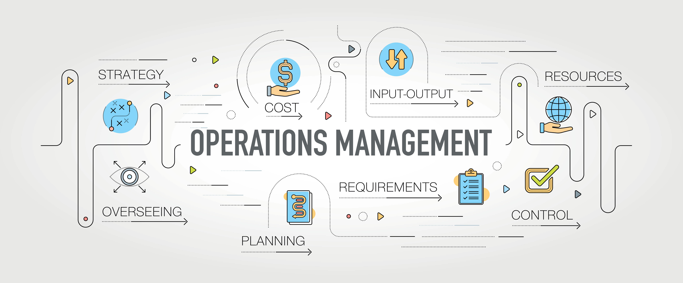
Location and Distribution
Supplier and Vendor Relationships
Adopt Efficient Processes and Technology
Physical or virtual location considerations
Brick and Mortar
Home Business
Hybrid
Establish trustworthy partnerships
Local
National
Global
Independent
Utilize project management and productivity tools
SaaS (Software as a Service) Common examples are email, calendaring, and office tools (such as Microsoft Office 365). SaaS provides a complete software solution that you purchase on a pay-as-you-go basis from a cloud service provider.

Slide 12

Managing Human Resources
Recruitment and Hiring Strategies
Employee Training and Development
Treat candidates like customers
Use social media
Implement an employee referral program
Create compelling job descriptions
Onboarding new hires
Matching mentors with mentees
Upskilling or reskilling initiatives
Teaching employees about the company's values, missions, and goals
Notes:
A PEO, or professional employer organization, is a type of full-service human resource outsourcing known as co-employment. In this arrangement, the PEO performs various employee administration tasks, such as payroll and benefits administration, on behalf of a business.

Slide 13

Evaluating and Improving Your Business
Set Performance Metrics
Regularly Review Business Processes
Measure success through KPIs
Customer acquisition costs
Customer churn rate
Profit margin
Employee productivity
Identifying bottlenecks, optimizing productivity, improving customer experience, reducing costs, adapting to changing market conditions, and staying competitive
Determine which business functions or operations need the most scrutiny.
Map out each step of the process to identify potential inefficiencies
Discuss potential solutions and changes based on findings.
Make necessary adjustments and monitor their impact.

Slide 14






Photo Collage
Summary of Key Points:
Effective Early planning
Financial Management
Legal Compliance
Diversify Marketing
Proficient Operations
Thank You
Q&A
Louie Picazo, CFE
louie@lolaconsultinggroup.com
www.lolaconsultinggroup.com
623.252.2518

