Slide 1





Setting Goals & Managing Time
to Grow Your Business
December 10, 2024
Nancy Sanders, Program Director, Maricopa SBDC
Sue Oliver, Director, Pima SBDC & Innovation

Slide 2
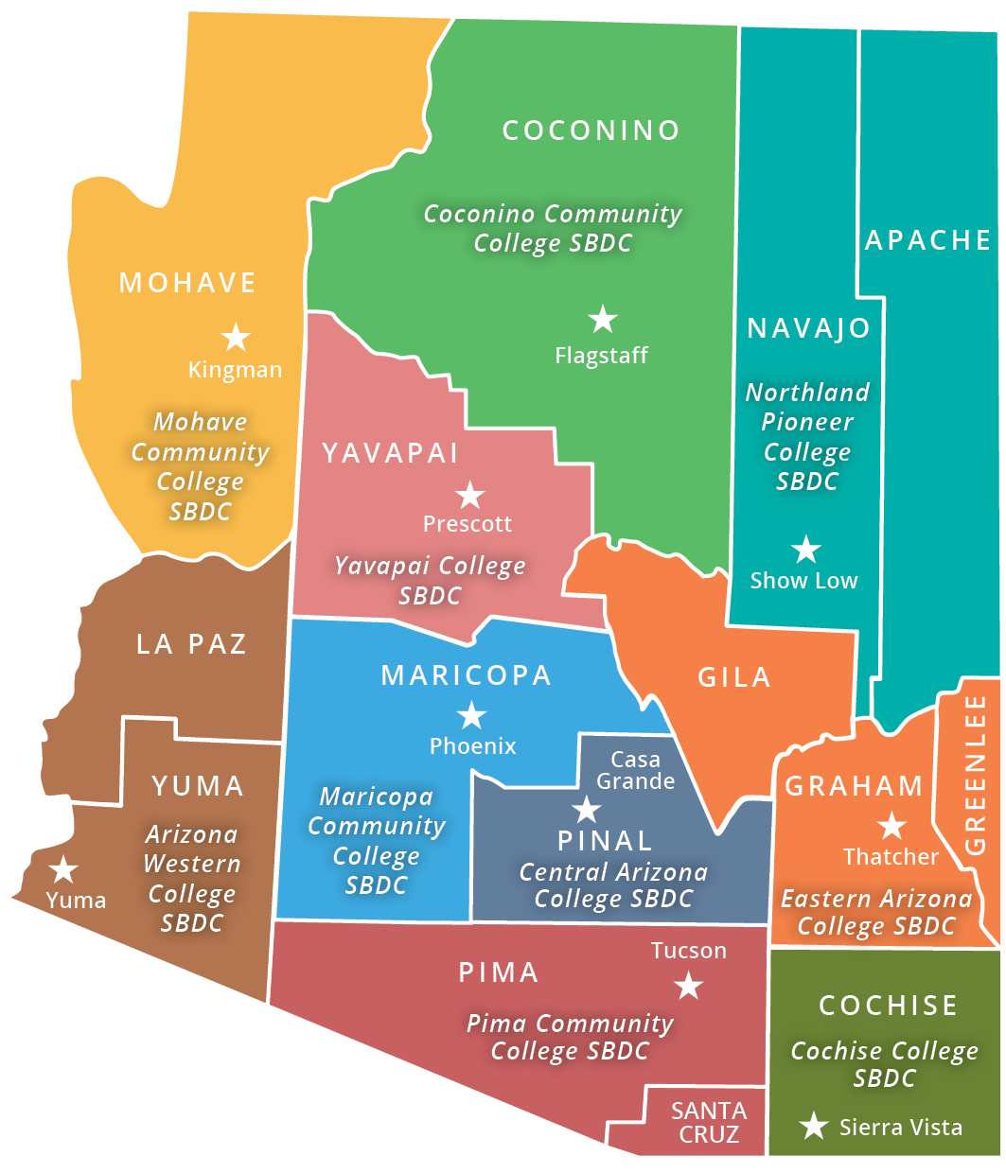

Who We Are
Arizona’s largest and most accessible statewide source of assistance for small businesses in every stage of development.
AZSBDC locations
To learn more, visit ArizonaSBDC.com

Slide 3

How We Serve Clients
Access to Capital for Growth
Business Planning - Growth Strategies
Financial Skills Development
Sales - Marketing – Operations
International Trade – Manufacturing - Technology
Counseling
In-Business Clients
New Starts
To learn more, visit ArizonaSBDC.com

Slide 4


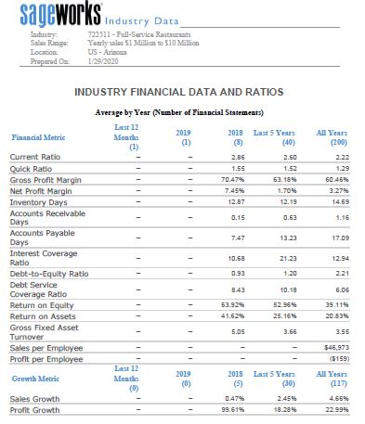
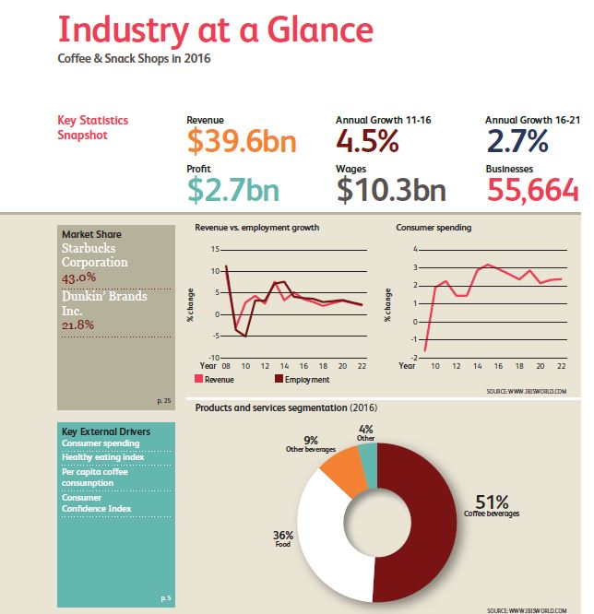
Tools to Grow and Access Capital
Tools to develop business plans, financial projections,
cash flow and profitability improvements.
Guidance in loan request and loan package preparation.
Funding strategies
Knowledge of commercial loans and SBA loan programs
Lender referrals
Alternative financing and equity sources
Grants
To learn more, visit ArizonaSBDC.com

Slide 5
Economic Impact (current calendar year)
Capital Formation | >$60M
New Business Starts | 492
Jobs Created | 1182
Revenue Increase | >$31M
Clients Advised | 4061
To learn more, visit ArizonaSBDC.com

Slide 6

Importance of Goals
Clarity
Focus
Efficiency
Performance
Team Buy-In
Accountability
Enjoyment!

Slide 7
Types of Goals
Personal and Professional
Short- and Long-Term
Quantitative and Qualitative
Profitability
Productivity
Wildly Important Goal (WIG)

Slide 8
SMART Goals
Specific: Well-defined, clear, and unambiguous
Measurable: With specific criteria to measure progress toward goal
Achievable: Attainable, realistic
Relevant: Makes sense for your company
Timely: Start and target dates

Slide 9
SMART Goal Examples
Increase sales (clients, profits)
Increase sales by 12/31/25
Increase net sales of our ABC products by 25% by year-end, improving net profit by at least 10%
Take two week-long vacations, one in May and one in October, with family (or friends)

Slide 10
What Is Your 2025 Profitability Goal?
Invest in the Business $50,000
Pay Down Debt $10,000
Pay Yourself $50,000
Profit Goal $110,000

Slide 11


What Is Your Wildly Important Goal (WIG) in 2025?
What Other Goals Support It?

Slide 12

Goal Setting: Common Mistakes
Too ambitious
Not ambitious enough
Vague
No deadline or accountability
Not inspiring

Slide 13
Goal Setting: Best Practices
Write them down!
Share/communicate them
Track them
Revise/update them
Make time for them

Slide 14

When I Say “Time Management,”
You Say…?

Slide 15
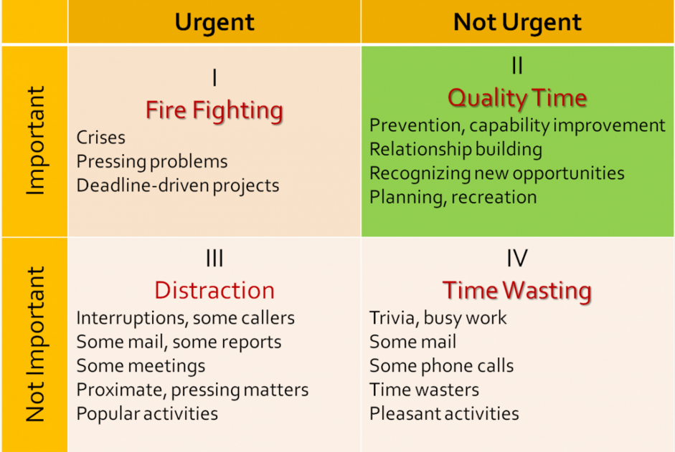
Where Do You Spend Your Time?
Source: The 7 Habits of Highly Effective People by Stephen Covey

Slide 16
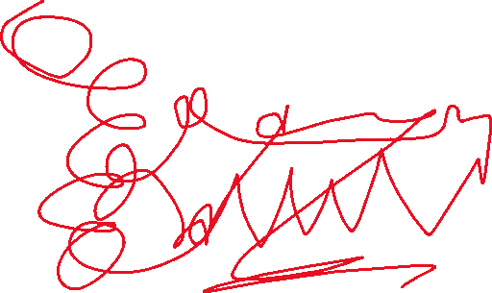
Where Do You Spend Your Time?
Source: The 7 Habits of Highly Effective People by Stephen Covey

Slide 17
Where Do You Need/Want to Spend Time?
"Quadrant II is the heart of effective personal management. It deals with things like building relationships, writing a personal mission statement, long-range planning, exercising, preventive maintenance, preparation -- all those things we know we need to do, but somehow seldom get around to doing, because they aren't urgent. To paraphrase Peter Drucker, effective people are not problem-minded; they're opportunity-minded. They feed opportunities and starve problems. They think preventively. They have genuine Quadrant I crises and emergencies that require their immediate attention, but the number is comparatively small.“
Source: The 7 Habits of Highly Effective People by Stephen Covey

Slide 18
Where Do You Need/Want to Spend Time?
Source: The 7 Habits of Highly Effective People by Stephen Covey

Slide 19
Time Management: Best Practices
Find your peak/golden time
Plan your day
Focus on one thing (vs. multi-tasking)
Reduce distractions
Rest/take breaks
Leverage tools
Use your mentors/coaches
Find what works best for YOU!

Slide 20
Tools to Increase Productivity
Project management (e.g., Trello, Monday, Asana)
Time tracking (e.g., Harvest, Clockify)
Communications, collaboration (e.g., Zoom, Teams, Slack)
Calendar/scheduling (e.g., Calendly, Outlook, Google)
Document/file management (e.g., GoogleDocs, Adobe Sign)
Mindmapping (e.g., Miro, MindMeister)

Slide 21

Questions?

Slide 22

www.ArizonaSBDC. com

