Slide 1


Business Financial Literacy
The Hidden Costs of Living Out of Your Business
www.lifemoveswealth.com
Notes:
Welcome, thanks for being here for todays Business Financial Literacy topic, The Hidden Costs of Living Out of Your Business.
This is a topic near and dear to my heart and I believe you’ll enjoy it as well.
As a quick housekeeping item, I encourage you to ask questions along the way rather than waiting until the end of the presentation – go ahead and strike while the iron is hot if you see or hear something that prompts a question - and I’ll do my best to keep us on-track and on-time.
There will be a couple of times during the presentation where I will ask for participation, so keep score at home and feel free to use the note sheets I’ve provided as an additional resource.

Slide 2


Meet your presenter
Dale L. Shafer II, CFP®, APMA®, CDFA®
Founder | Financial Advisor | CCO
Life Moves Wealth Management
www.lifemoveswealth.com
Notes:
Hi, I’m Dale L Shafer II, I serve as a financial and exit planning advisor for business owners and high-level business professionals. The reason I’ve tailored the work I do around business owners is this: business owners have a high need for financial guidance for both their personal and business lives, and it’s often difficult for the average business owner to gain access to quality advice until the business can be monetized and the owner gets a pile of money that needs to be managed. I believe there’s a better way!
I am proud to hold professional designations, including the CERTIFIED FINANCIAL PLANNERTM (CFP®), Accredited Portfolio Management AdvisorTM (APMA®), and Certified Divorce Financial Analyst (CDFA®). I’m currently pursuing the Certified Business Exit Consultant (CBEC®) with expected completion summer 2024.
My wife is a total gem – her name is Melisa. We married in 2010 and have four children, three of whom are currently in college in three different states. And, we welcomed our “next-gen” kid to our family in April 2021.
Out of the office, I am most likely found exploring outdoors, hiking, road cycling, and camping. You might also see me rocking out behind a drum kit or a guitar.
Enough about me – let’s get to the good stuff!

Slide 3
What we will cover in today’s topic:
Shed light on the detrimental effects of the practice of living out of your business.
How your business finances, tax efficiency, and ultimately your valuation are negatively impacted.
How to separate personal and business finances to promote business financial health.
www.lifemoveswealth.com
Notes:
The presentation aims to shed light on the detrimental effects of living out of your business.
How this practice always leads to accounting confusion, makes it difficult to track business performance, and potentially causes other legal or tax issues.
Throughout the presentation, we'll explore strategies for avoiding this practice, promoting financial health, strong governance, and sustainability.

Slide 4

www.lifemoveswealth.com
Notes:
What do you see in this image? What’s happening here?
Would you fire this employee? If so, why?
Now, imagine this is not an employee. This is you, the business owner. Still feel as strongly about what’s happening here?
This is actually a good representation for what it looks like, as the owner, to intentionally live out of your business. So, let’s put some definition around this term.

Slide 5
Defining living out of your business
Using business funds to cover personal expenses.
Common grey areas: groceries, travel, clothing, personal/family meals, and entertainment expenses.
Creates blurred financial boundaries.
www.lifemoveswealth.com
Notes:
The term “Living out of your business” refers to using business funds to cover personal expenses.
Examples of personal expenses that are often improperly mixed with business finances include groceries, personal travel, and entertainment expenses. Sometimes car loan payments and gas can be “ran through the business”, but may not qualify as a true business expense if said car is just used for the owner’s commute to an office and personal travel – no true business use. Same for things like home and auto insurance, cell phones, utilities for your primary residence – even if you have a home-based business, etc.
While it might seem convenient to use the business card or even petty cash funds for grey area personal expenses, maintaining clear boundaries between personal and business finances to ensure financial transparency, accountability, and legal compliance.
Let’s dive in!

Slide 6
The cost of mixing personal and business finances
Tracking true business financial health is difficult.
Challenge of managing cash flow effectively.
Legally, a breach of your fiduciary duty!
www.lifemoveswealth.com
Notes:
When personal and business expenses are mixed, it becomes difficult to differentiate between the two, making it hard to track the financial health of the business accurately. It also blurs the lines between personal liability and business liability, which can have serious legal implications in the event of lawsuits, bankruptcy, divorce, or when you eventually want to sell the business.
A major challenge is managing cash flow effectively when personal expenses are taken out of the business. This can lead to a business not having enough working capital to operate effectively. What I have seen in these situations is the owner will avoid taking a paycheck and instead use the business card to cover their bills.
Stated simply: Using your business as a personal piggy bank for your own benefit is not only bad practice, it’s a breach of your fiduciary duty as an officer of the company.

Slide 7
This practice becomes quite tax inefficient
Both the owners and the business risk missing out on valuable tax deductions.
Difficult to reduce taxable income.
Increases audit risk.
www.lifemoveswealth.com
Notes:
From a tax perspective, without clear separation between personal and business expenses, business owners risk missing out on valuable tax deductions that could help lower their tax liability.
It’s tempting to think that paying some personal expenses through the business might be deductible, so better to ask forgiveness than permission... Right?
The lack of documentation and clear records can raise red flags with tax authorities and potentially lead to costly audits or fines. No business owner wants to be unnecessarily tied up with a tax audit. Not only the audit, but having to restate financials, amend prior year returns, and take on an unexpected and unwelcome tax bill with interest and penalties as a result!

Slide 8
The impact on business value
Challenging to accurately assess the true value of the business.
Less attractive and riskier to potential investors.
Business’s creditworthiness likely to suffer.
www.lifemoveswealth.com
Notes:
The impact extends beyond day-to-day operations and taxes—it can also affect the overall value of your business.
The lack of financial transparency can raise concerns about the reliability of financial statements and the overall health of the business. If a potential buyer, lender, investor, or supplier perceives a mess when looking at your financials, your business becomes less attractive… and what does that mean? A big discount for the buyer, less favorable borrowing terms, and even less favorable invoicing terms.
Of course, this also impacts your business's creditworthiness, which adds to the difficulty of securing favorable terms from lenders and suppliers. Non-favorable terms can become a tax on your cash flow management, and a big selling discount becomes a tax on your personal financial security.

Slide 9
Business is a professional services office with:
1 professional
1 full-time office manager (earning ~$55k annual salary)
3-4 regular part-time employees
www.lifemoveswealth.com
Notes:
Now that we’ve covered this in concept, let’s look at a real-world example:
Here’s a financial health review using a business P&L and Balance Sheet.
This is a professional services office, the Costs of Goods sold – or operating expenses – should be largely related to the people working in the the business… the primary professional, the front desk staff, office manager, etc. In this case, it doesn’t involve widgets being produced, so there are very few inputs for materials.
Using round numbers, if the office manager’s $55k salary is included in the COGS, and it should be – this leaves approx. $110,000 to pay the part-time employees. Can you pay 3-4 people decently to work part-time in an office setting?
How much would be left over to pay the professional who is necessary for earning the revenue??
In this case, the professional is simply taking net profit distributions and using the business credit card to cover personal expenses of approximately $35,000-$40,000 per year.
With that in mind, is this gross profit line inflated? Does this make the business appear to look more profitable than reality? Why or why not?
Would it be difficult to properly assess the financial health and therefore value this business if you were a potential investor, buyer, or lender?
What could this owner do differently?
[CLICK] Here’s what this will look like once we move the owner’s personal expenses from G&A up to COGS. The owner is now taking a salary of $50,000 and not using the business card or personal expenses. In this case, the owner will still be able to receive net profit distributions as needed or desired, but this at least puts separation between business and personal expenses and makes the gross profit look more realistic.
At the same time, there are additional business efficiencies that can be explored to reduce G&A expenses, and possibly see if those marketing dollars are being used as effectively as possible.

Slide 10
Pro-tips for separating your finances
Designate business bank accounts exclusively for business transactions – and don’t fudge it!
Use accounting software to better categorize and track expenses.
If it looks like a personal expense, it mostly likely is a personal expense.
Set a defined owner compensation and run it through payroll.
www.lifemoveswealth.com
Notes:
To mitigate the negative impact of mixing personal and business finances, it's essential to implement strategies for separation. One basic and effective strategy is to establish a separate business bank account exclusively for business transactions. While this seems obvious, some business owners do not take this step.
Utilizing accounting software can also help business owners track expenses more effectively. One of my newer clients was living completely out the business when we started working together – we created a spreadsheet with all the business expenses and created two columns – one labeled P and the other B – if it was unclear, we labeled it personal. This owner then started payroll for themselves and shifted the “P” expenses to their personal bank account. Whatever works for you! By categorizing transactions and maintaining clear records, it becomes easier to differentiate between personal and business expenditures. If you aren’t comfortable with doing this on your own, outsource a bookkeeper to help you keep everything straight and properly accounted. This is crucial for pass-through entities, as it can drastically influence your correct taxable income.
Additionally, setting a regular salary for yourself as the business owner helps ensure that personal expenses are accounted for separately from business expenses, promoting financial transparency and accountability. For pass-through entities (sole-proprietorships, partnerships, LLCs, and S-Corps): you may hear different numbers here, but my opinion is that once the net income of the business crosses $100,000, you should be cash-flow positive and can therefore establish regular W-2 income for yourself.
Recommended salary amounts may vary based on business type and incorporation status… a starting point may be adding up owner’s personal expenses and talk with your CPA to understand where your tax “sweet spot” may be.

Slide 11
Benefits of separating your finances
Better insights into business financial health = better decision making!
Clear financials instills confidence and credibility for potential buyers or investors.
Reduces risk of legal and tax issues, promotes good financial and business governance.
www.lifemoveswealth.com
Notes:
Maintaining separate personal and business finances offers numerous financial benefits. Clearer financial records enable better financial management and decision-making, providing insights into the business's financial health and performance.
Instills confidence and credibility in your financials. It helps paint a clearer picture of how dependent the business is on the owner vs. just seeing how much the owner takes out of the business.
Moreover, separating personal and business finances reduces the risk of legal and tax issues, protecting the business and its owners from potential liabilities and penalties. It ensures compliance with tax regulations and promotes good financial governance.

Slide 12
Additional resources
Episode 37 of the Financial Purpose Podcast: How to use EBITDA to drive your business
www.lifemoveswealth.com/business-owners
Arizona Commerce Authority Small Business Owner resources
Profit First by Mike Michalowicz to learn a simple system for splitting accounts, paying yourself first, and driving profitability
www.lifemoveswealth.com
Notes:
Where can you find additional resources?
Profit First: tell how I use it for business and personal finances.
First person to send an email to info@lifemoveswealth.com with your name and email address, I'll send a copy of this book to you.

Slide 13
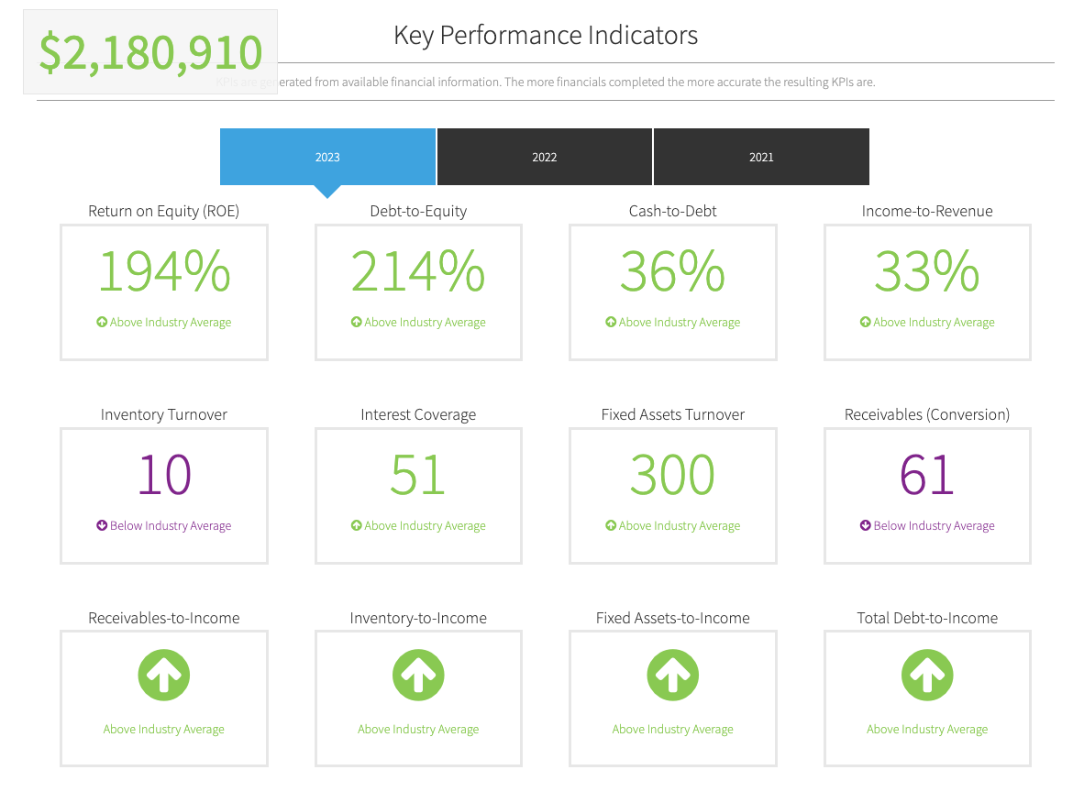
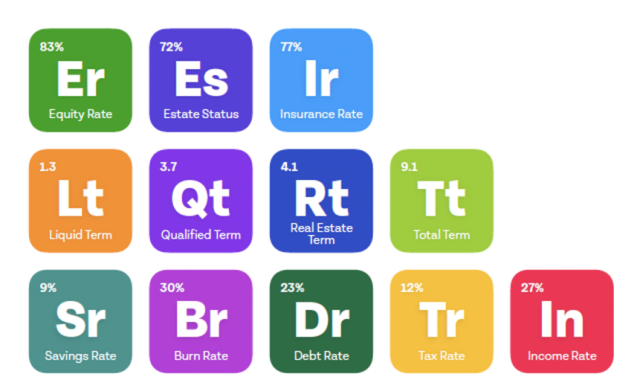
Are you financially healthy?
What about your business?
BONUS!
www.lifemoveswealth.com
Notes:
This is a topic I talk about with my business owner clients on a regular basis. We review their business financials and identify areas of opportunity to become more profitable, less wasteful, and ultimately more valuable over time. This focus also helps them create a better business culture for their employees.
Many business owners start a business, grow revenues, and eventually consider selling only to find out they aren’t financially ready to be independent of their business – and, often the business is not worth as much as they hoped!
This is where I become incredibly valuable to you. Ask yourself:
Are you financially healthy? How about your business? How would you know for sure?
Anyone attending this session today can get a free review of their personal AND business financial health. This will give you a significant advantage and help you run your business better.
Tired of feeling cash-flow strapped? Not saving as much as you need to for yourself – or at all? Have you gone periods without paying yourself to make sure you can float payroll? Unsure of when you might reach financial independence? If you answered YES to any of these, this offer is for YOU!
For attending today, you can receive complimentary personal and business financial health review. This review will give you personal and business KPIs to help you understand your financial health and what next steps you may need to take to reach your next level of growth. Business owners and professionals get actionable guidance for their most important questions at Life Moves Wealth.
Again, there’s no cost or obligation to do anything but know where you stand. Please take me up on this offer – no one else in town is looking at business and personal financial health for business owners like we do! Scan the QR code on your note sheet, or on the next slide to get started.

Slide 14

Ready to take your next steps?
I can help!
Scan to get started today!
www.lifemoveswealth.com
Notes:
Life Moves Wealth Management is an Independent, fee-only wealth and exit planning advisor for business owners and professionals. Fee-Only model means I don’t receive commissions, incentives, or added management costs to steer you in one direction or another. It also means I don’t focus on asset minimums – this allows more owners to have access to solid financial advice long before they sell their business.
You’re a business owner or high-level professional. We understand your unique personal and business financial planning challenges.
Whether you’re just getting started, thinking about selling, or somewhere in between, you’re in the right place.
At Life Moves Wealth, we’re all about making you financially awesome! Scan this code and click on the “financially healthy” icon to get started.
Thank you for attending today!

Slide 15
Life Moves Wealth Management, LLC (“LMWM”) is a registered investment advisor offering advisory services in the States of Arizona, Indiana, and in other jurisdictions where exempted. Registration does not imply a certain level of skill or training. The presence of this website on the Internet shall not be directly or indirectly interpreted as a solicitation of investment advisory services to persons of another jurisdiction unless otherwise permitted by statute. Follow-up or individualized responses to consumers in a particular state by LMWM in the rendering of personalized investment advice for compensation shall not be made without our first complying with jurisdiction requirements or pursuant an applicable state exemption. All written content on this site is for information purposes only. Opinions expressed herein are solely those of LMWM, unless otherwise specifically cited. Material presented is believed to be from reliable sources and no representations are made by our firm as to other parties’ informational accuracy or completeness. All information or ideas provided should be discussed in detail with an advisor, accountant or legal counsel prior to implementation.
www.lifemoveswealth.com

Slide 16
Reference material
Link
Link

