Slide 1

Online Business Tools Everyone Needs
Productive, Organized, Confident
Notes:
Hi everyone and thank you for being here today!
My name is Michael Jesse, owner of Curiosity Center. Curiosity Center is a learning and development center focused on the study of creativity to help organizations develop creative leadership, innovative strategy, and create high performance teams through leadership development, organization development, and coaching programs.
Today, I am going to show how to be more productive and organized with your inbox. And show up more confident once you have your email, to-do list, and your calendar working for you.
As business leaders we need to use our creativity in multiple ways. Strategic planning, revenue operations, customer service, and many other activities. Now, to be creative we need time for ideate and create, however one place that robs our time is our inbox. So today, I am going to focus on how to actually achieve Inbox Zero and be more productive by synchronizing our mail and calendar with two other online tools. One is a CRM platform and the other is a project management platform.
So, let’s get started.

Slide 2
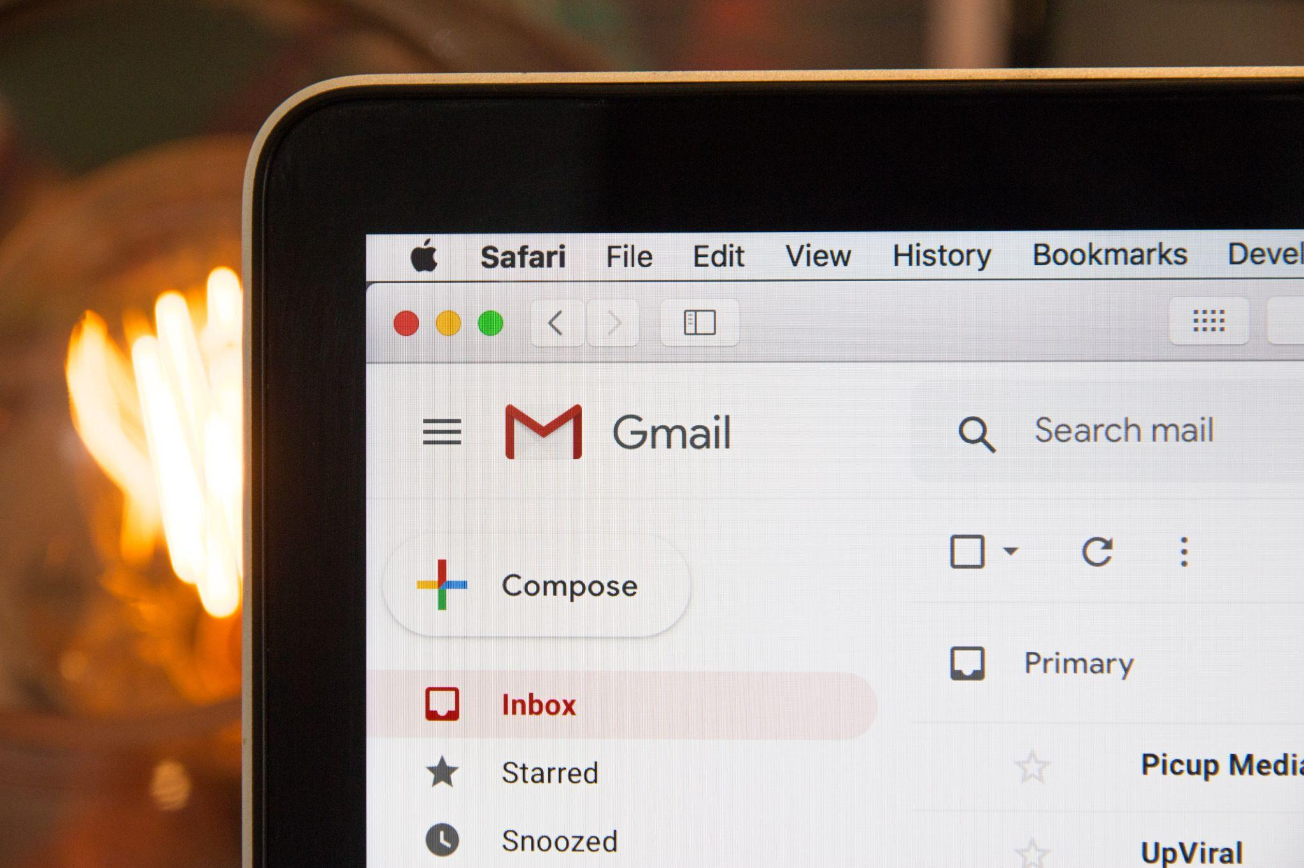
Inbox Zero and Productivity
Merlin Mann coined the term Inbox Zero to help people alleviate stress and accomplish more by a method to deleting, deferring, or doing.
We receive an estimated 120 emails per day and send about 40 per day.
That’s a lot!
Notes:
[transition] Merlin Mann coined the term Inbox Zero to help people alleviate stress and accomplish more by a method of deleting, deferring, or doing.
[transition] We currently receive an estimated 120 emails per day and send about 40 per day.
[transition] That’s a lot!
Now, this gets even worse if your role relies on emails for revenue operations or customer service.
As a business owner or solo entrepreneur, you might be spending more time looking at your inbox. And on top of that, you have your personal email to contend with at the same time.
In this webinar we will find a real way to triage your incoming mail and feel confident about deleting them.

Slide 3
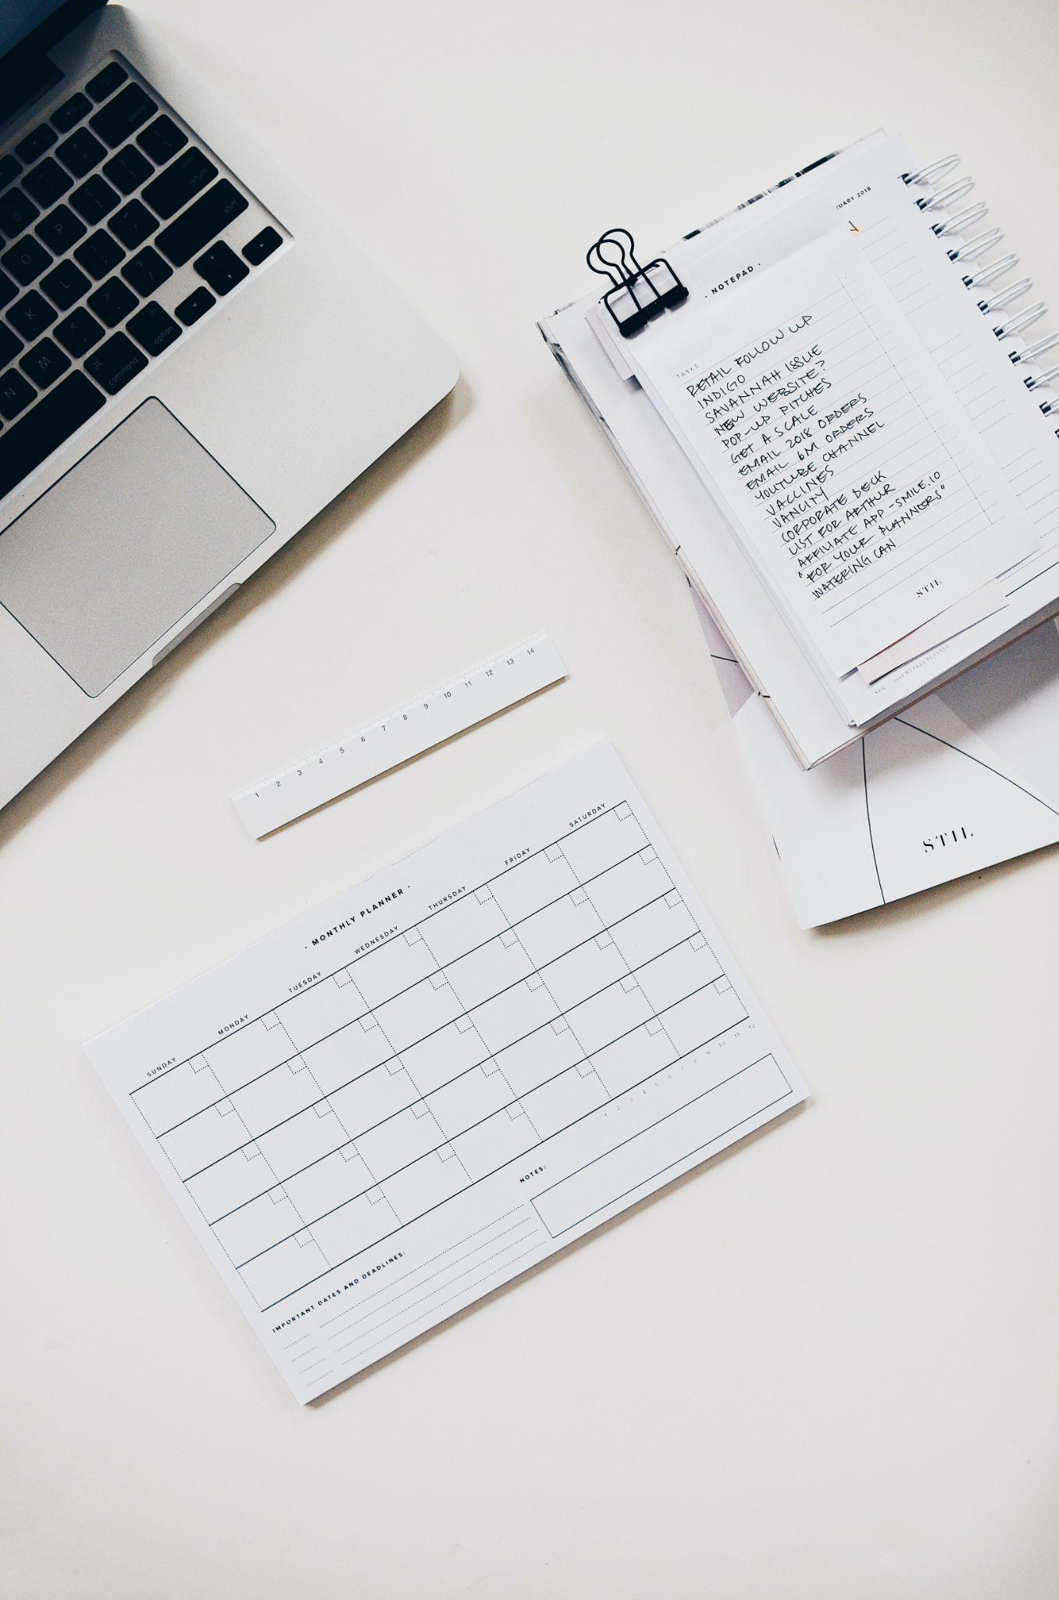
To Do Lists are AWFUL!
The amount of time wasted with to-do lists is uncanny.
Most people spend 1-2 hours creating or reviewing their tasks.
🗒️ TIP: If you are spending more than 5-10 minutes per day creating or reviewings tasks, you have too many tasks
Notes:
[transition] I have spent so much time optimizing, redesigning, evaluating to-do lists to the point where I have literally given up on to-do lists.
[transition] The average person can spend from 1 to 2 hours creating or reviewing their tasks per day. That is just insane and a waste of time.
The issue stems from the fact that our to-do lists come from multiple sources.
Family, Friends, Work, other people’s Emails.
Today, we’ll discuss all those incoming messages and how to handle them in a way that matches with our Inbox Zero goals.

Slide 4
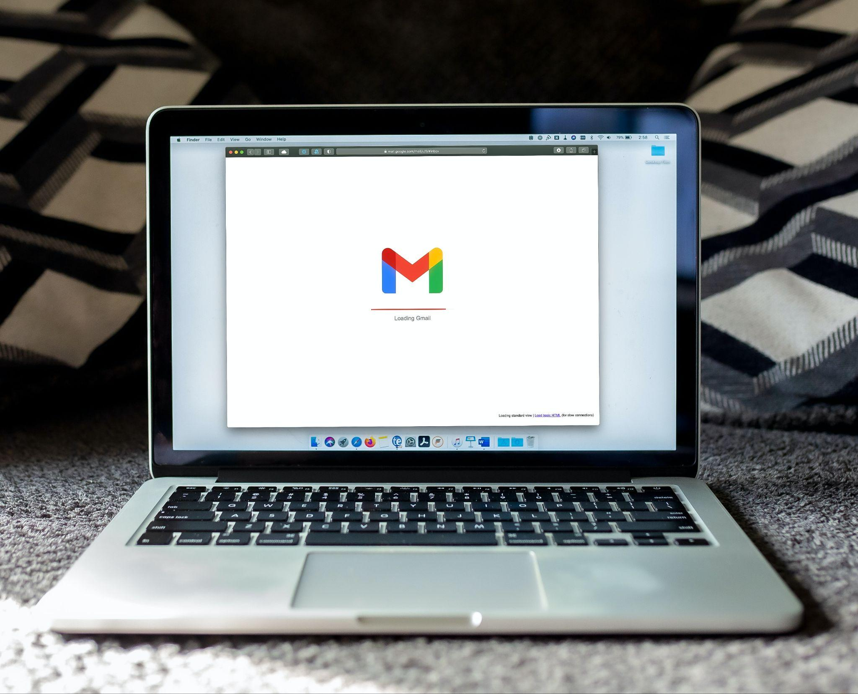
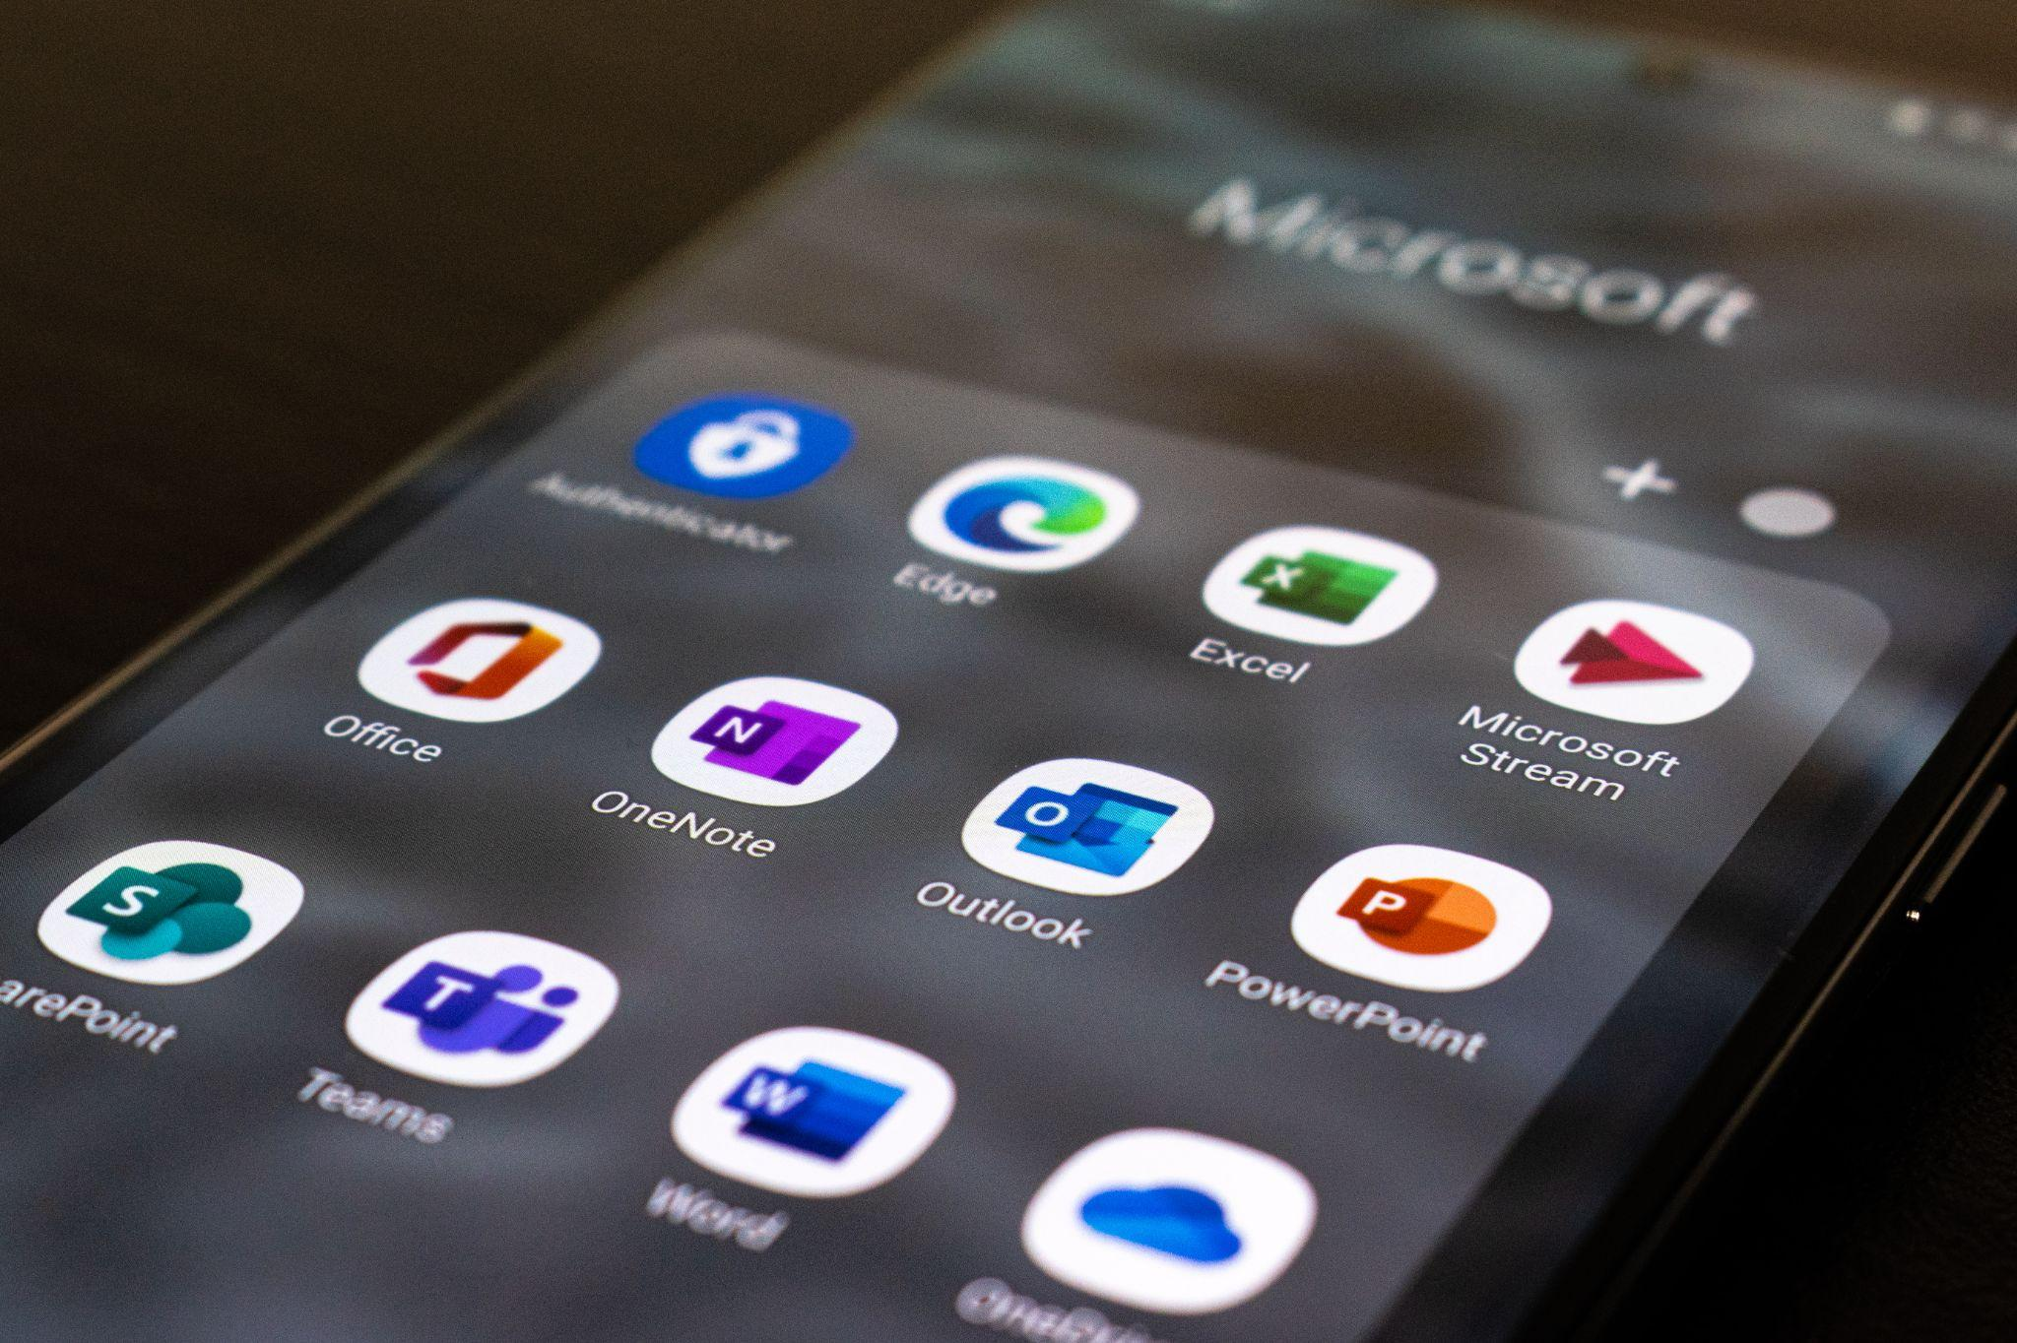
Google and Microsoft
Notes:
We are going to be discussing this in relation to Google and Microsoft Mail and Calendar.
If you are using iCloud, Yahoo, AOL, ProtonMail, or something else, you can still use the Hubspot CRM and ClickUp tools, but you will not have the automation or integration that you need.
If you are already using those other email tools for your business and you do not want to change, that’s fine.
For those who are using Google and Microsoft, I’ll show how to manage your mail and calendar better.

Slide 5
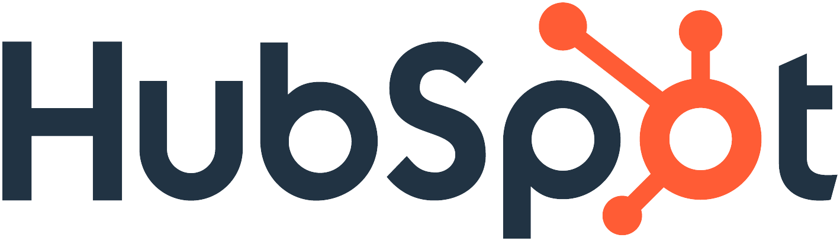
Notes:
Next up, we need a CRM tool that will allow us to defer our conversations.
The reason I like Hubspot CRM is its integration with both Google and Microsoft mail and calendar.
WIth Hubspot, we can log our conversations and schedule a time to follow up with either an email or phone call.

Slide 6
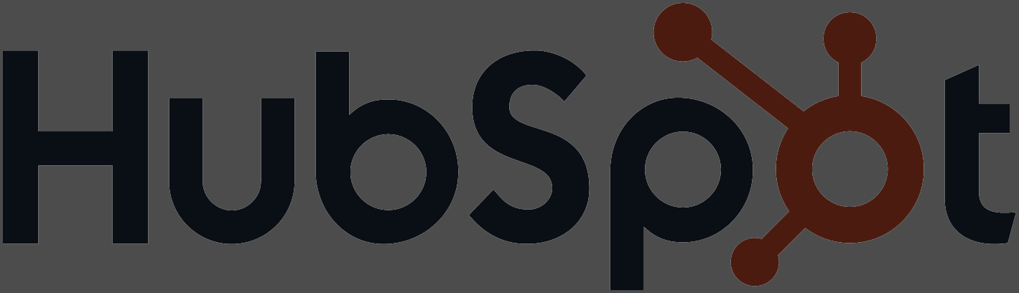
Hubspot Feature Focus and Google Demo
Integration - Contacts Synchronization
Integration - Calendar Synchronization
Hubspot Settings Mail Extension
Log Email
Hubspot Tasks

Slide 7

Notes:
Next up, we need a project management tool that will allow us to defer our work. ClickUp will replace your to-do list completely. No more just setting deadlines, now we have a way to schedule our work.
The reason I like ClickUp is its integration with both Google and Microsoft calendar.
WIth ClickUp, we can schedule our projects and our to-do list items and get a clear picture of what we are working on.

Slide 8

Clickup Feature Focus and Google Demo
Calendar Synchronization - Bidirectional
Space - Lists : Routines, Projects, Project Requests, Lists
Time Estimates
Calendar View

Slide 9
Recommendations
💡 If you have 5 team members or less, use one Hubspot and ClickUp accounts for both personal and business use.
💡 If you have email that is older than 6 months, just DELETE it. UNSUBSCRIBE EVERYTHING! Subscribe only to those things that is helping you grow.
💡 Once you are back from vacation, block off adequate time to triage your inbox and review your existing projects and list items.
💡 Make this a daily habit. Schedule how often you want to check email and stick to it.

Slide 10
Online Business Tools Everyone Needs
Summary
⭐️ Inbox Zero can be a real thing
⭐️ Stop using To-Do lists
⭐️ Create and organize your conversations
⭐️ Create and organize your projects and tasks

Slide 11

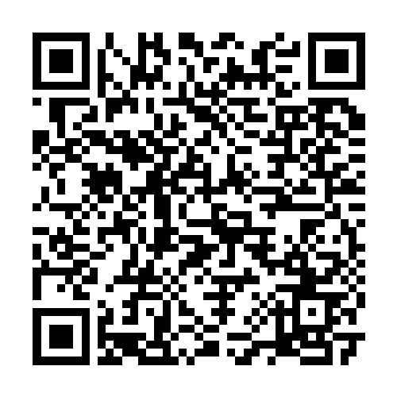
Please complete the feedback form. This helps me improve this topic and by doing so, I’ll be sending out a free gift!
Michael Jesse
📧 michael.jesse@curiositycenter.net
🌎 curiositycenter.net
☏ +1 (520) 815-6192

Slide 12
References
Google Workspace Learning Center
Microsoft 365 from Microsoft Learn
HubSpot Academy
ClickUp University

