Slide 1
SCORE for the Life of Your Business
Notes:
Instructor Note: For use with people who may or may not have been assessed already and are just interested in learning more.

Slide 2
Why SCORE Works
FREE Mentoring and Co-Mentoring helps minimize risk and provides a sounding board for ideas and operations.
FREE Workshops We provide training on critical topics in an environment where you can learn from experts and like-minded entrepreneurs.
FREE Online Resources can be your playbook to provide step-by-step outlines for small business strategies.
We’re here for the life of your business – providing free advice for as long as you own your business.

Slide 3



The SCORE Story
We help small businesses by:
Providing free business advice and mentoring
Offering low or no-cost business training
Sharing free business templates and resources

Slide 4

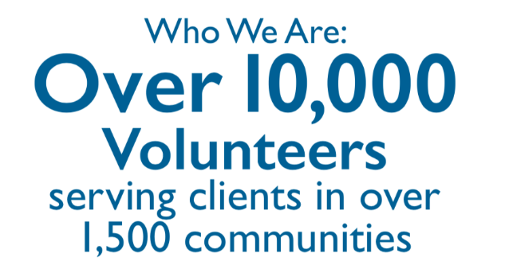
The SCORE Story
This is possible through the effort of our volunteers nationwide.

Slide 5
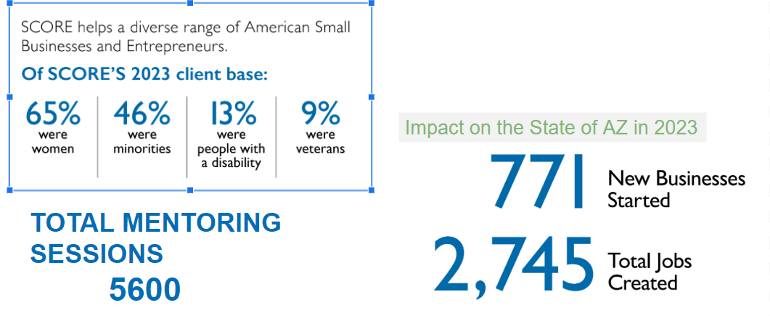
SCORE IMPACT ARIZONA

Slide 6
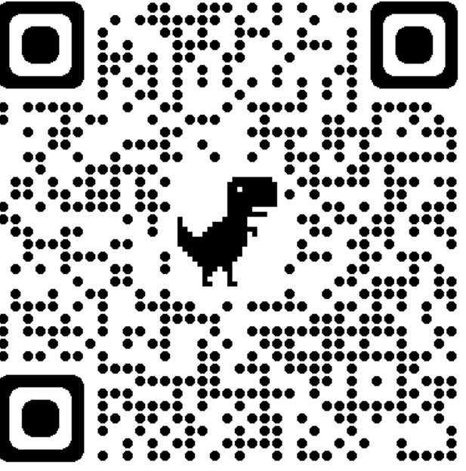
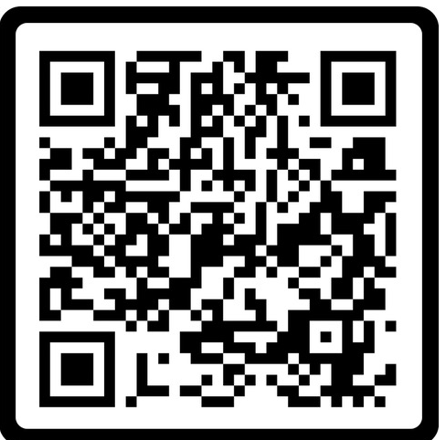
Request a Mentor or Volunteer
REQUEST A MENTOR
BECOME A VOLUNTEER
https://www.score.org/find-mentor/request-mentor
Send an Email contactus@score.org

