Slide 1


Creating and Leading Productive Teams
“Creating Highly Productive teams are so rare… Align the people to the work is what’s missing”
Donna Hover-Ojeda
Chief Strategist
Notes:
‹#›

Slide 2
Our Agenda Today
Teams and Mind Set Change
High Performing Teams
Building Productive Teams
Activities of Work
Categories of Work
Stages of Work
Action you can Take
‹#›
Copyright © Mighty Underdogs Company
Notes:
‹#›

Slide 3
How teams are typically created
Teams are typically given/assigned to us
Who’s available at the time
A group is NOT a team
Internal Members
Use of GIG workers
‹#›
Copyright © Mighty Underdogs Company
Notes:
‹#›

Slide 4
Assessments about the People
StrenthFinders
DISC
Meyers Briggs
Predictive Index
360
‹#›
Copyright © Mighty Underdogs Company
Notes:
‹#›

Slide 5
How Work Gets Done
80% about the work
20% about the people
‹#›
Copyright © Mighty Underdogs Company
Notes:
‹#›

Slide 6


Slide 7
What is a High Performing Team?
They deliver results ahead of time, under budget, and generate “what’s next”
FIRST = identify what activities are required for the project
SECOND = They assess what skills or talents are needed
THIRD = identify who has the skills/talents for each phase of the project.
‹#›
Copyright © Mighty Underdogs Company
Notes:
‹#›

Slide 8
Understanding the Work
Working Genius Model - by Patrick Lencioni
Distills any kind of work down to six fundamental activities
How people fit into the process of work
3. Provides teams with a better way to think about their dynamics, projects, meetings and even their hiring.
‹#›
Copyright © Mighty Underdogs Company
Notes:
‹#›

Slide 9
Six Activities in Work
Wonder - energy from asking “why is it this way” (external)
Invention - loves to come up with new ideas (internal resources)
Discernment - Great instincts/patterns if it is going to work/not
Galvanizing - inspiring others to come together, ambassadors
Enablement - gathering necessary tools to make it happen
Tenacity - bring it over the finish line!
‹#›
Copyright © Mighty Underdogs Company
Notes:
‹#›

Slide 10
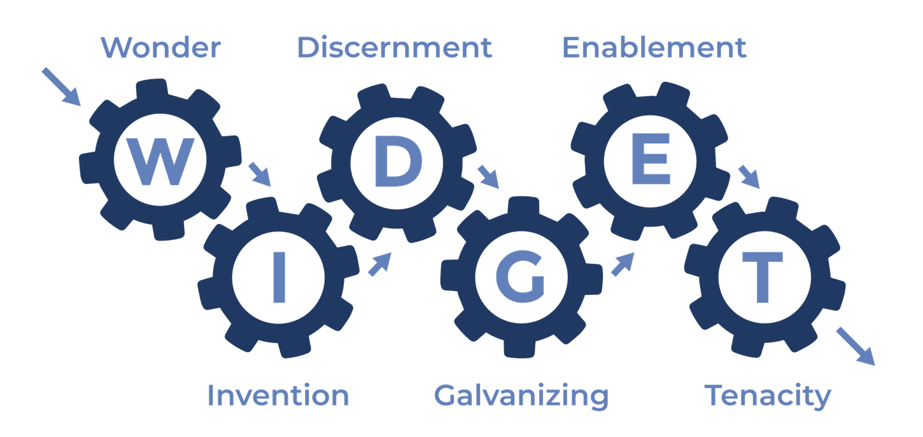

Slide 11
Two in Each Category
Passion - Energizes us, doesn't feel like work
2. Competencies - can do time to time but not long term
3. Frustrations - work that must be done
‹#›
Copyright © Mighty Underdogs Company
Notes:
‹#›

Slide 12


Slide 13
Effective Teams
How To Overcome Team Dysfunctions
Before you reach out to others, first identify, “What does the work require?” so that you can clarify which stage of work is needed.
‹#›
Copyright © Mighty Underdogs Company
Notes:
‹#›

Slide 14
HOW DO PEOPLE FIT

Slide 15
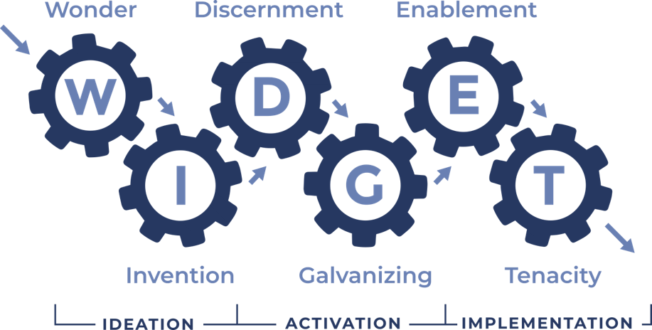
Three Stages of Work

Slide 16
TEAM MAP
TEAM MAP

Slide 17
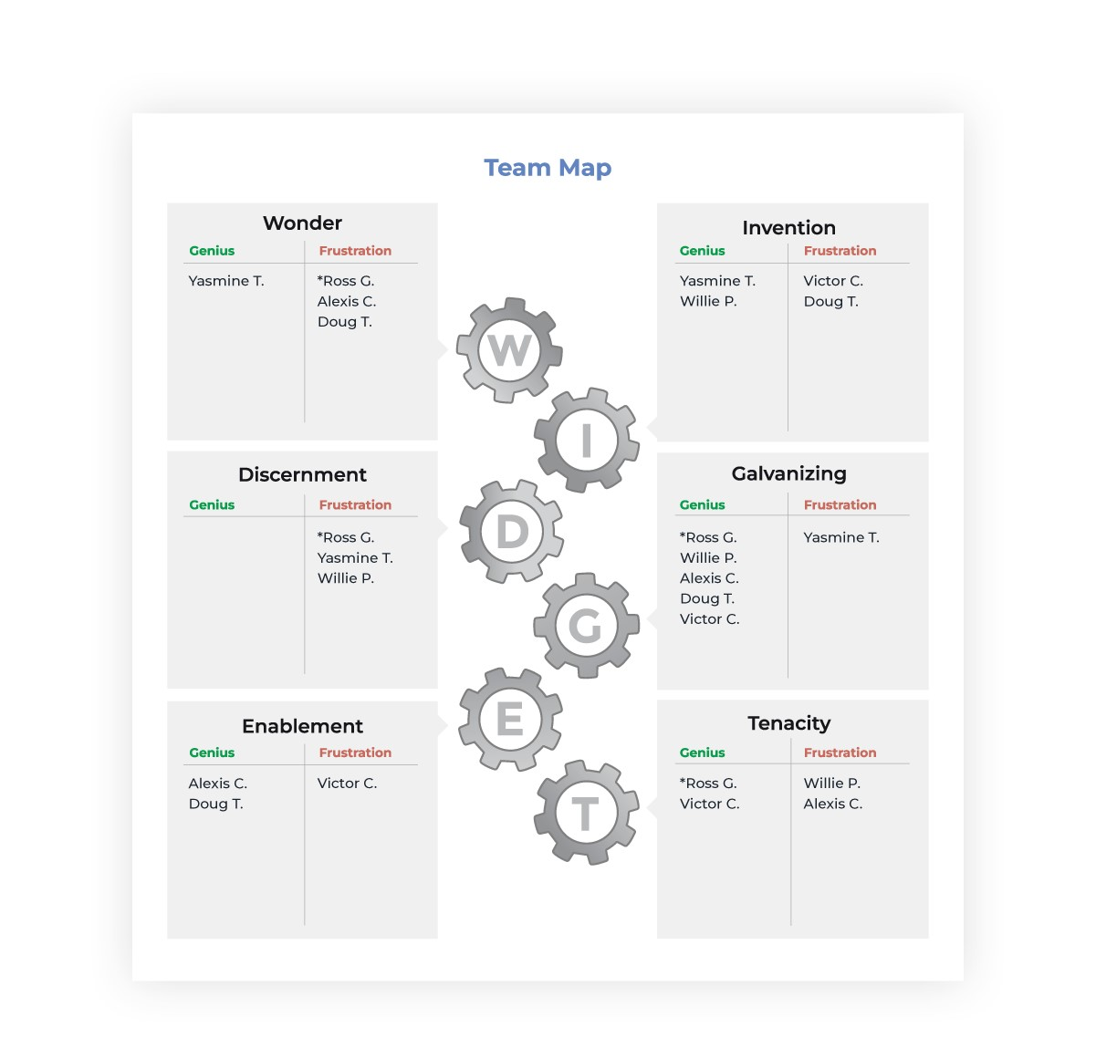

Slide 18
ACTION ITEMS:
Learn your WIDGET combination www.workinggenius.com
What part of the work flow brings you JOY, Competent, and frustration?
Have your team take the assessment to create a map for your team.
Understanding yourself and your team members “6 Types of Working Genius”
‹#›
Copyright © Mighty Underdogs Company
Notes:
‹#›

Slide 19
"If everyone is moving forward together, then success takes care of itself." — Henry Ford
‹#›
Copyright © Mighty Underdogs Company
Notes:
‹#›

Slide 20


Contact Information
Donna Hover-Ojeda
Mighty Underdogs Company
520-500-6616
donnahover@mightyunderdogs.club
www.mightyunderdogs.club
‹#›
Copyright © Mighty Underdogs Company
Notes:
‹#›

Slide 21
