Slide 1

Avoiding the Top Tax Mistakes that Small Businesses Make
Lisa Novack
Notes:
Good morning everyone. On behalf of IRS, I would like to thank you for inviting me to share information with you today.
My name is Lisa Novack and I am a Sr. Stakeholder Liaison with the Communication and Liaison Division within the IRS.
A little about myself…I have been with IRS since 1987, starting as a Tax Auditor and eventually getting into education and outreach around 2001
As a small business owner, there is a lot for you to know…not only tax rules but you have to be aware of other guidance as well, So it’s good to review the basics, even if you have a tax preparer or someone assisting you.
And it’s important to ensure that you’re filing taxes correctly, not only to ensure that you only pay taxes on what you’re required to but you also want to reflect an accurate picture of your finances on your tax return, especially if you’re seeking financing, either for personal or business.
So, today, I’d like to share some information about how to avoid some common tax pitfalls that small business makes and I’ll also share some helpful resources with you that you can refer to later. And since we just kicked off the new filing season, I wanted to share some of the newest messaging with you that might be helpful to you as you get ready to file.
It’s important for you to know where to go to get the latest, greatest information, rather than listening to your neighbor Bob and doing things the way he does it. ☺
We hope you will find this presentation both helpful and informative.

Slide 2
Agenda
Recordkeeping
Report all taxable income
Keep business expenses separate
Review return for accuracy
Consider e-file options
Don’t fall prey to tax scams
Choose your tax preparer carefully
Do your homework
Classifying Workers
Notes:
This slide shows you some of the topics that we will be covering today to avoid the top tax mistakes.
Not listed are a few topics that you might find helpful as you get ready to file. These are some of IRS Key messages and newer programs.
That’s a lot to cover, so let’s begin.

Slide 3
Recordkeeping
Maintain records needed to figure your income.
Keep records needed to figure your deductions:
  Cancelled checks
  Receipts
  Other evidence
Retain records for as long as you may need them
Notes:
Our first tip to help you avoid tax trouble is to make sure you keep good records. You can use any recordkeeping method that works for you, but make sure the method you use provides you with all of the information you need to calculate your income and figure your deductions.
You need to make sure you have proper recording methods and internal controls to accurately compute your income.
On the expense side you must keep cancelled checks, receipts and other evidence of expenses you paid.
You must retain your records for as long as they are important for any tax law. This is usually the later of the following dates.
3 years from the return due date or the date filed.
2 years after the tax was paid
There are some circumstances that could require you to keep your records a longer time, but these are good general guidelines.

Slide 4
Report all Taxable Income
Report all taxable income on your return
Most income is taxable unless it is specifically exempted by law.
You can receive income in the form of
  Cash
  Check
  Credit Card
  Non-cash exchanges such as bartering
Notes:
Another way to avoid tax trouble is to make sure you report all of your taxable income. Filing a tax return and reporting taxable income is more than just checking a few boxes and signing your name to a form. This may seem obvious, but you must report all taxable income on your tax return. Do you know what types of income are considered taxable to avoid tax trouble?
All income is taxable unless the law specifically excludes it. Income for your business can include many forms, such as cash, checks, or credit card payments, or the exchange of property or services, called bartering. Bartering is the exchange of one product or service for another, including through the internet. Both parties must include the fair market value of goods or services received as income on their tax return. With bartering, you must include the value of the non-cash income from the exchange as income.
So it’s very important to come up with a reliable recordkeeping system to ensure you are properly and timely accounting for your income.

Slide 5
Keep Business Expenses Separate
Avoid claiming personal expenses as business expenses – always keep these separate.
Three top expenses reviewed by IRS
  Home Office Deduction
  Auto Expenses
  Travel and Entertainment Expenses
Notes:
Moving on to our next potential pitfall for tax trouble – claiming personal expenses as business expenses.
To be deductible, a business expense must be both ordinary and necessary.
An ordinary expense is one that is common and accepted in your trade or business.
A necessary expense is one that is helpful and appropriate for your trade or business. An expense does not have to be indispensable to be considered necessary.
If you keep your business and personal records separate, it will go a long way to avoid this common mistake.
Keeping separate business and personal bank accounts will go a long way to help this as well.
While there are many examples we could go over, let’s look at three top expenses that are looked at very carefully by IRS.
Home Office Deduction
Many taxpayers work at home these days. If you have a home office, personal expenses are never allowed as a business expense. Business expenses must be kept separate and good record keeping is a must when you have a home office. *The IRS released a simplified option for use when claiming this expense this year (in 2013). So if you are normally eligible to claim this expense, check out the new guidance on IRS.gov before filing next time.
Highlights of the simplified option:
Standard deduction of $5 per square foot of home used for business (maximum 300 square feet).
Allowable home-related itemized deductions claimed in full on Schedule A. (For example: Mortgage interest, real estate taxes).
No home depreciation deduction or later recapture of depreciation for the years the simplified option is used.
Requirements to Claim the Home Office Deduction
Regardless of the method chosen, there are two basic requirements for your home to qualify as a deduction:
Regular and exclusive use.
Principal place of your business.
Regular and Exclusive Use.
You must regularly use part of your home exclusively for conducting business. For example, if you use an extra room to run your business, you can take a home office deduction for that extra room.
Principal Place of Your Business.
You must show that you use your home as your principal place of business. If you conduct business at a location outside of your home, but also use your home substantially and regularly to conduct business, you may qualify for a home office deduction.
Publication 587, Business Use of Your Home
Frequent Business Vehicle Use
Just as it's easy to mix personal with business use in a home office business vehicles are also ripe for unqualified deductions. This doesn't mean you can't claim a business vehicle, but make sure you have a detailed log with the date, destination and mileage for each trip – and that you don't include stop-offs for coffee or dry cleaning. In most cases, you can claim either the standard mileage rate or a percentage of the actual expenses you incur operating that vehicle. Of course, standard mileage rate is probably the easiest.
Publication 463, Travel, Entertainment, Gift, and Car Expenses.
Business "Entertainment"
If you're self-employed, it's tempting to claim lots of meals and travel on the Schedule C you file with your tax return. But you can avoid tax trouble by claiming only the proper expenses allowed by the law. If you're claiming business-related trips, it's crucial to keep detailed records and receipts of who was there and event specifics. - Publication 463 Travel, Entertainments, Gifts and Transportation
There have been recent changes in the tax laws to expenses for meals and for entertainment.
Under the Tax Cuts and Jobs Act, Entertainment Expenses are no longer deductible, anything considered to constitute entertainment, amusement, or recreation (entertainment expenditures).
You can continue to deduct 50% of the cost of business meals if you (or your employee) are present and the food or beverages aren't considered lavish or extravagant.
______________________________________________________________________________
______________________________________________________________________________

Slide 6
Review Return for Accuracy
Double-checking each line
Watch for common mistakes
  Incorrect/missing SSN(s)
  Incorrect tax
  Computation errors
  Withholding/tax payments on wrong line
*Mistakes can delay processing
Notes:
Avoid tax time pitfalls by reviewing your return. Anytime you file a tax return you should always review your return for accuracy. Double-check every single line before mailing your form – especially if you're a do-it-yourself filer.
A few of the most common tax return errors are:
Incorrect or missing social security numbers.
Incorrect tax entered based on taxable income and filing status.
Computation errors in figuring the taxable income, withholding and estimated tax payments, Earned Income Credit, Standard Deduction for age 65 or over or blind, the taxable amount of social security benefits, and child and dependent care credit. Also, missing or incorrect identification numbers for child care providers.
Withholding and estimated tax payments entered on the wrong line, and
Math Errors. Both addition and subtraction. Most electronic software programs will help you avoid this. We’ll talk about this as one of the advantages of filing electronically in a minute.
It is important that you review your entire return because any errors may delay the processing of your return.
Make sure you understand everything and are comfortable with the accuracy of the return before you sign it. Speaking of that, don’t forget to sign the return – believe it or not, that’s another common mistake!

Slide 7
Consider E-file Options
Choose IRS e-file
Direct deposit
Electronic payment options
Preparer should offer e-file
Notes:
These tips apply to all taxpayers, not just business taxpayers.
When you are ready to file your return, consider IRS e-file, which will help cut back on math errors that may cause you tax trouble.
Best of all, you’ll get your refund faster with Direct Deposit. And, you can split your direct-deposit refund among as many as three accounts, including an option to buy U.S. Savings Bonds. If you owe tax, you can file early and delay paying with several E-pay options including credit cards.
Make sure your preparer offers IRS e-file. Any paid preparer who prepares and files more than 10 returns for clients must file the returns electronically, unless the client opts to file a paper return. IRS has safely and securely processed more than one billion individual tax returns since the debut of electronic filing in 1990.
Be careful not to get caught in tax and/or refund scams. Let’s discuss that next….

Slide 8
Don’t Fall Prey to Tax Scams
Tax scams / “sounds too good to be true”
Abusive tax schemes evade taxes
  False deductions
  Improper use of trusts
“Dirty Dozen” news release
Tax Scams/Consumer Alerts page on IRS.gov
Check out the “Business” section on IRS’s Identity Theft Central at IRS.gov/IdentityTheft.
How to know it’s really the IRS calling or knocking on your door
Notes:
The saying “if something seems too good to be true, it probably is” applies equally as well to tax scams as it does to other types of financial scams. An abusive tax scheme is used to evade taxes. Abusive tax scheme programs range from the simple false deductions to the very complex such as promoters improper use of trusts to avoid paying the proper amount of tax.
SCAM CALLS AND EMAILS PERSIST. Please use caution. You probably already know you owe taxes…you’ve probably received mail (even if you don’t open it) if you get a call, hang up and call the IRS.
Avoiding these schemes will keep you out of tax trouble. Every year the IRS issues a “Dirty Dozen” list of tax scams taxpayers may encounter during the year and there is also a Tax Scams/Consumer Alerts page on IRS.gov to help you recognize and avoid such scams. See also: How to know it’s really the IRS calling or knocking on your door
Phishing schemes - The “IRS Refunds” scam is a common tactic used by cybercriminals to trick people into opening a link or attachment associated with the email that takes people to a fake page where thieves try to steal personally identifiable information.
Threatening Impersonator Phone Calls - The IRS warns of a new twist on an old phone scam as criminals use telephone numbers that mimic IRS Taxpayer Assistance Centers to trick taxpayers into paying non-existent tax bills.
Fake Payments with Repayment Demands - After stealing client data from tax professionals and filing fraudulent tax returns, criminals use the taxpayers' real bank accounts for the deposit. Thieves are then using various tactics to reclaim the refund from the taxpayers, and their versions of the scam may continue to evolve.
Fake Charities
Social Media scams
Senior Fraud
Scams targeting non-English speakers
Businesses can also be targets so be sure to check out the business section at IRS.gov/identitytheft.

Slide 9
Carefully Choose your
Tax Return Preparer
Be aware of return preparer fraud
60% of taxpayers seek professional help
  Most preparers are honest
  Some prey on unsuspecting taxpayers
*You are legally responsible for your return
IRS.gov/chooseataxpro
Notes:
Even if you use a preparer to complete your business returns, and 60 % of taxpayers do, you still have to be cautious and choose your preparer carefully.
Most return preparers provide honest service to their clients. But, as in any other businesses, there are also some who prey on unsuspecting taxpayers. If you choose to pay someone to prepare your return, remember you are legally responsible for what is on your return.
Be aware of what we call Ghost Preparers – those who prepare a return for payment but do not sign it or efile it.
New IRS Tool Can Help You Find a Tax Preparer - The IRS has launched a new, online public directory of tax return preparers. Now you can use this tool to help you select a tax return preparer with the credentials and qualifications that you prefer. Go to IRS.gov/chooseataxpro

Slide 10
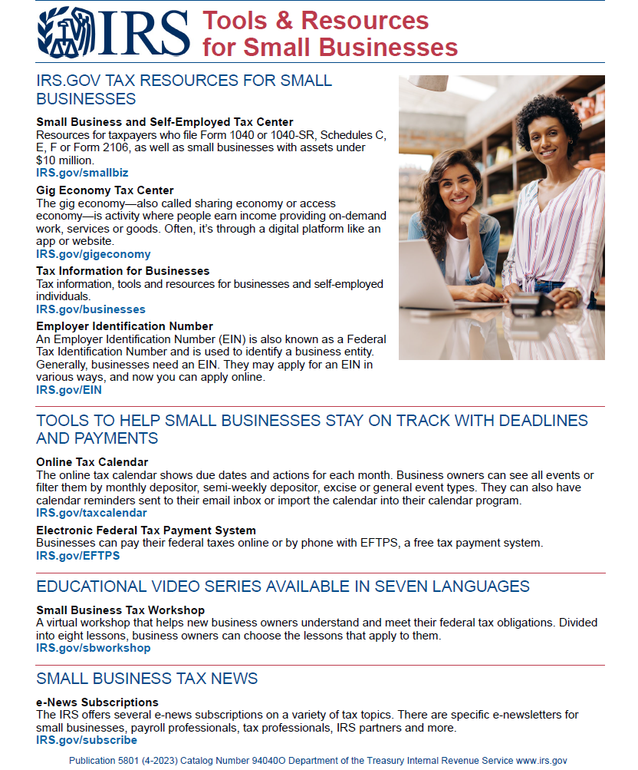
Tools & Resources
Notes:
You don’t need to be a “tax expert” to run your business, but you do need some tax basics to educate yourself.
Check out our web site, at IRS.gov. Just type in the keyword “Business” and you can navigate to the Tax Information for Business page and locate all this great info.
It has a comprehensive list of helpful publications for small businesses and other small business tools on the Small Business and Self-Employed Center web page. The Small Business and Self-Employed Tax Center has information on taxes, recordkeeping, accounting practices, completing federal business and employment tax returns, and meeting other federal tax obligations.
Or if you are just starting a business, a good place to begin is the Starting a Business page on IRS.gov.
IRS Video Portal site, will give you the information you need to stay tax compliant.
Also, bookmark our Online Learning and Educational Products page where you can choose products such as the Tax Calendar desktop tool and view videos on a variety of topics, to help you learn more about business taxes on your own time and at your own pace. You cn even access the Virtual Small Business Tax Workshop from here

Slide 11
Resources
Here are some of our top recommendations for you to review.
Publication 583 – Recordkeeping
Publication 525 – Taxable/Nontaxable Income
Publication 587 – Business Use of Your Home
Publication 463 – Travel, Entertainment, Gift, and Car Expenses.
Tax Scams / Consumer Alerts | Internal Revenue Service (irs.gov)
Dirty Dozen Tax Scams
IRS.gov or call 800-TAX-FORM (800-829-3676)
Notes:
We have more tips and information on IRS.gov to help you plan, claim loses and get assistance from us that you can look at anytime you need to.
Here are some of our top recommendations for resources for you to review:
Publication 583 – Recordkeeping
Publication 525 – Taxable and Nontaxable Income
Publication 587 – Business Use of Your Home
Pub 463 has info on a variety of topics, including the Standard Mileage rates (http://www.irs.gov/uac) and information about entertainment.
And these particular pages on IRS.gov;
Tax Scams — How to Recognize and Avoid Them
IRS Releases the Dirty Dozen Tax Scams for 2012
Tax booklets are also available at IRS.gov or by calling 800-TAX-FORM (800-829-3676)

Slide 12
Worker Classification: Employee or Independent Contractor?
Notes:
Time for a little test for you
True or False
A business owner can decide whether to treat a worker as an employee (and withhold taxes) or as an independent contractor.
Answer: False. Classification of workers depends upon a number of different factors that must be addressed.
This is another area where there seems to be a lot of misunderstanding. So if you have or plan to hire workers, you’ll want to make sure to classify them correctly.

Slide 13

Worker Classification
Workers you hire may be:
  Independent contractors
  Employees
Determination
Publication 1779
Notes:
If a worker is an employee, then the employer is responsible for withholding income tax and the employee’s portion of Social Security and Medicare tax from amounts paid to the worker. The employer is also responsible for paying over to the IRS the employer’s portion of Social Security and Medicare tax, as well as paying the Federal Unemployment Tax.
On the other hand, the business is not responsible for any payroll taxes for independent contractors.
Many companies believe that they can choose whether to treat any given worker as an employee or independent contractor. However, there are laws which determine whether the worker is an employee or an independent contractor. So the first step is to properly classify the worker.
The screen shows you a picture of our Publication 1779, Independent Contractor or Employee. The information we are covering is discussed in the publication, as well as on the IRS web site, and links to both the publication and the web pages are on the Resources slide at the end of this topic.

Slide 14
Employee vs. Independent Contractor
  Categories of Evidence:
    Behavioral control
      Type of instruction given
      Degree of instruction
      Evaluation systems
      Training provided by the business
    Financial control
      Significant investment
      Unreimbursed expenses
      Opportunity for profit or loss
      Services available to the market
      Payment method
    Type of relationship of the parties
      Written contract
      Employee-type benefits provided
      Relationship Permanency
      Key business activity provided by services
Notes:
Employee vs. Independent Contractor
To determine whether an individual is an employee or an independent contractor under the common law, the relationship of the worker and the business must be examined.
In any employee-independent contractor determination, You need to consider all information that provides evidence of the degree of control and the degree of independence must be considered. (Not just one or two factors)
Facts that provide evidence of the degree of control and independence fall into three categories of evidence:
behavioral control,
financial control, and the
type of relationship of the parties.
To decide whether the business is exercising the type of control that would classify the worker as an employee (rather than an independent contractor), look at facts in these three categories of evidence:
Behavioral Control: Does the business control or have the right to control what the worker does and how the worker performs the services?
Financial Control: Are the business aspects of the worker’s work controlled by the business? (these include things like how the worker is paid, whether expenses are reimbursed, who provides equipment/tools/supplies, etc.)
Could the worker face a loss on the job?
DO they hold themselves out for services to others or do they just primarily work for you?
Type of Relationship: Are there written contracts or employee-type benefits (i.e. pension plan, insurance, vacation pay, etc.)? Will the relationship continue, and is the work performed a key aspect of the business?

Slide 15
Resources
Visit IRS.gov, search Keywords
“Worker Classification”
Pub 1779, Independent Contractor or Employee
Publication 15-A Employer's Supplemental Tax Guide
Form SS-8, Determination of Worker Status
“SS-8 Determinations of Worker Classification” (examples)
Pub 1976, Section 530 Relief Requirements
Notes:
Here are some additional resources you can go to for additional information on worker classification.
Publication 15-A has some great industry examples to help make a determination as to worker classification.
The second bullet from the bottom actually takes you to real life submissions of Form SS-8 and the outcome. So that is a good resource as well.

Slide 16
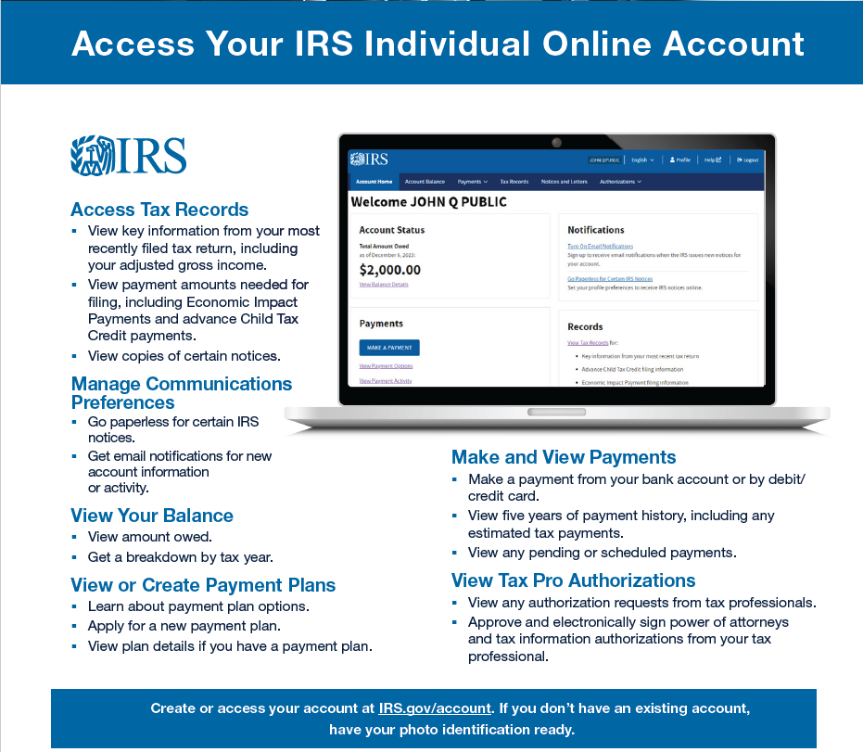
Individual Online Account
Notes:
How many of you know that you can set up your own account on IRS.gov to access your own information??
Encourage you to sign up before you may actually need to access.
ID.me
There are additional features available to individual taxpayers from their Online Account. Taxpayers can view:
The amount they owe, updated for the current calendar day
Their balance details by year
Their payment history and any scheduled or pending payments
Key information from their most recent tax return
Payment plan details or request a payment plan
Digital copies of select notices from the IRS
Their Economic Impact Payments, if any
Their address on file
Taxpayers can also:
Make a payment online
See payment plan options and request a plan via Online Payment Agreement
Access their tax records via Get Transcript
Tax Pro Account – can be used to submit POA electronically (processed automatically), can review and withdraw POAs on file, view TP info such as bal due.

Slide 17
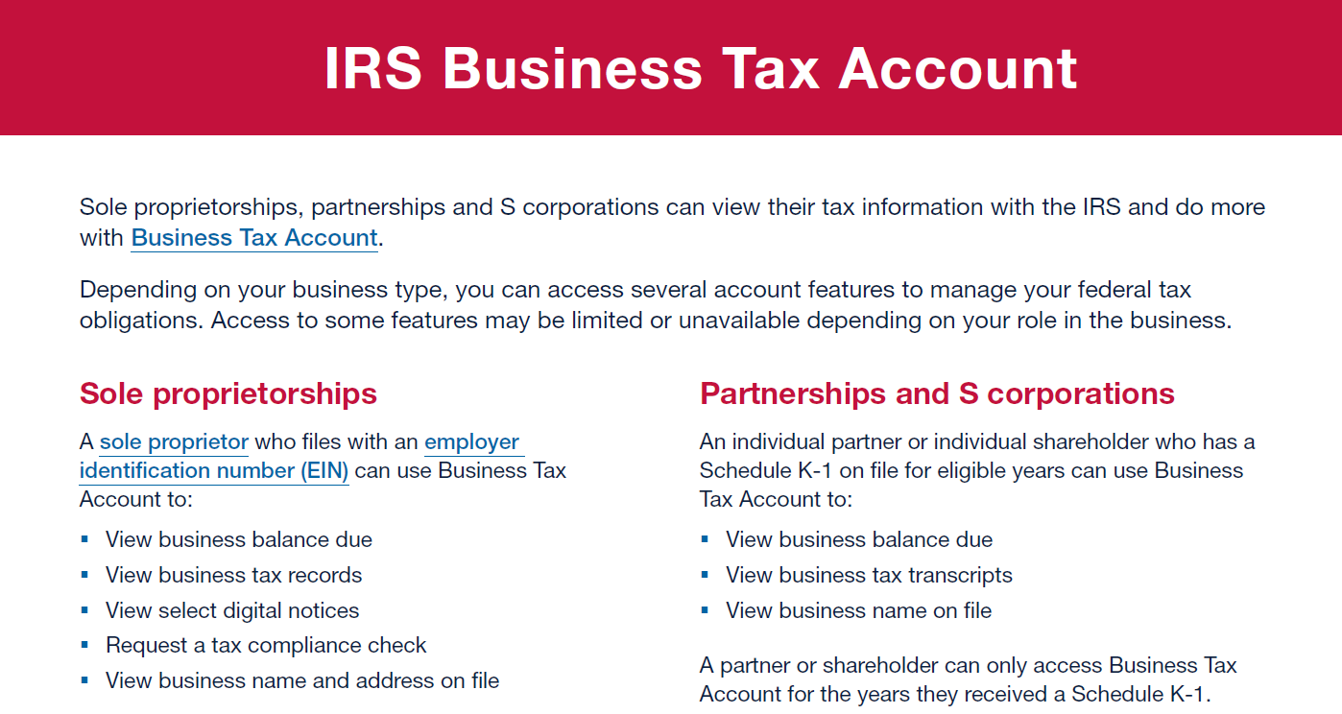
IRS Business Tax Account
IRS.gov/businessaccount
Notes:
IRS.gov/businessaccount
Sole proprietorships, partnerships and S corporations can view their tax information with the IRS and do more with Business Tax Account.
Depending on your business type, you can access several account features to manage your federal tax obligations. Access to some features may be limited or unavailable depending on your role in the business.
Sole proprietorships
A sole proprietor who files with an employer identification number (EIN) can use Business Tax Account to:
.View business balance due
.View business tax records
.View select digital notices
.Request a tax compliance check
.View business name and address on file
Partnerships and S corporations
An individual partner or individual shareholder who has a Schedule K-1 on file for eligible years can use Business Tax Account to:
.View business balance due
.View business tax transcripts
.View business name on file
A partner or shareholder can only access Business Tax Account for the years they received a Schedule K-1.
How to use it
If you have an IRS Individual Online Account, use the same login at IRS.gov/businessaccount. If you don’t have an account, have your photo ID ready to verify your identity.
For your personal taxes, use IRS Individual Online Account.Publication 5904 (1-2024) Catalog Number 94579C Department of the Treasury Internal Revenue Service www.irs.gov

Slide 18
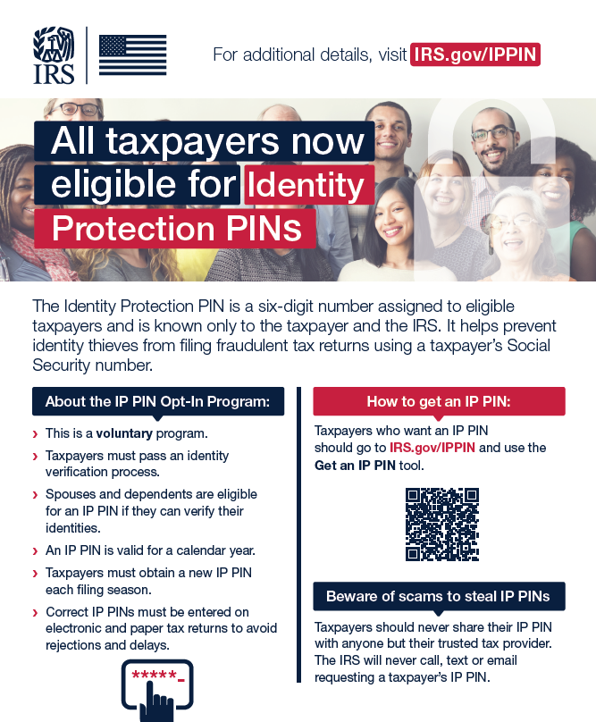
Communications & Liaison
STAKEHOLDER LIAISON
Publication 5477
Notes:
Unfortunately, occasionally scammers may get your personal information and use it to file a false tax return using your information. This can create issues in getting it resolved and could potentially delay the processing of your refund.
To avoid this potential issue, you can apply for an IP PIN and proactively protect your federal tax account from identity theft.
An electronically filed return filed without your IP PIN, or an incorrect IP PIN, will reject, including your return and any fraudulent returns using your Social Security Number.
Any paper returns filed without your correct IP PIN will undergo additional scrutiny and any fraudulent returns will be removed from your account. If the return verifies to be yours, we will continue to process it.
Located on IRS.gov at www.irs.gov/ippin

Slide 19
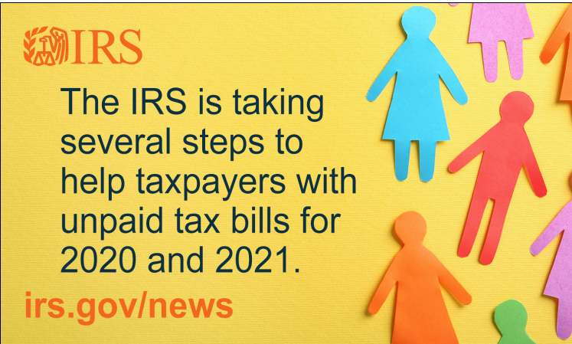
Communications & Liaison
STAKEHOLDER LIAISON
Penalty Relief
IR-2023-244 IRS helps taxpayers by providing penalty relief on nearly 5 million 2020 and 2021 tax returns; restart of collection notices in 2024 marks end of pandemic-related pause.
Notes:
As the IRS has been preparing to return to normal collection mailings, they have been concerned about taxpayers who haven't heard from us in a while suddenly getting a larger tax bill.
The IRS temporarily suspended the mailing of automated reminders to pay overdue tax bills starting in February 2022. These reminders would have normally been issued as a follow up after the initial notice. Although these reminder notices were suspended, the failure-to-pay penalty continues to accrue for taxpayers who did not fully pay their bills in response to the initial balance due notice.
The IRS is also taking steps to waive the failure-to-pay penalties for eligible taxpayers affected by this situation for tax years 2020 and 2021.
To help taxpayers as the normal processes resume, the IRS will be issuing a special reminder letter starting in January. The letter will alert the taxpayer of their liability, easy ways to pay and the amount of penalty relief, if applied. The IRS urges taxpayers who are unable to pay their full balance due to visit IRS.gov/payments to make arrangements to resolve their bill.
This penalty relief is automatic. Eligible taxpayers don't need to take any action to get it. Eligible taxpayers who already paid their full balance will benefit from the relief, too; if a taxpayer already paid failure-to-pay penalties related to their 2020 and 2021 tax years, the IRS will issue a refund or credit the payment toward another outstanding tax liability.

Slide 20
Form 1099-K Third Party Payment Network Transactions
(Card and Electronic payments)
Notes:
There have been some changes to the requirement for third party payment networks to issue Form 1099-K.
Think of some of the payment apps such as Venmo, Cash App, PayPal.
So if you accept payments or get paid through certain apps, you may be getting a 1099-K for the first time. Also if you do business through online market places.
We’ll talk more about this in a coming slide.

Slide 21
Form 1099-K Overview
  The American Rescue Plan Act of 2021 changed the Form 1099-K reporting threshold to payments over $600 beginning in calendar year 2022.
  Implementation was delayed for calendar years 2022 and 2023.
    For 2023, Forms 1099-K reporting threshold, over $20,000 and over 200 transactions
    Some taxpayers may still receive a Form 1099-K
    Report all income, unless excluded by law
  IRS is planning for a $5,000 threshold for 2024.
Notes:
The Form 1099-K reporting threshold for third party payment network transactions was over $20,000 and 200 transactions.
The American Rescue Plan Act of 2021 lowered the reporting threshold to total gross payments of more than $600 for the year, regardless of the number of transactions for calendar years after December 31, 2021. The law further clarified that the minimum reporting threshold for calendar years after 2021 applies only to payments settled through payment settlement entities like payment apps and online marketplaces for the sale of goods or services; there is still no threshold for payment card transactions.
The threshold change did not change the definition of reportable payments.
The IRS announced that 2022 was a transition year and on November 21, 2023, the IRS announced that 2023 will be another transition year to implement the new requirement.
This means that for 2023, popular payment apps and online marketplaces are required to send out Forms 1099-K only to taxpayers who receive over $20,000 and have over 200 transactions instead of payments over $600. This was in response to feedback from taxpayers, industry and stakeholders and was intended to help reduce confusion and provide more time for taxpayers and stakeholders to prepare and understand the lower reporting threshold.
Despite the delay, some taxpayers may still receive a Form 1099-K in January 2024 for payments they received with totals below the $20,000 and 200 transaction thresholds.
The IRS is planning a $5,000 threshold for tax year 2024 as part of a phased-in approach to implement the $600 reporting threshold enacted under the American Rescue Plan. The IRS is still assessing if there will be a requirement for the number of transactions with the $5,000 reporting threshold. This phased-in approach will allow the agency to review its operational processes to better address taxpayer and stakeholder concerns.
It’s important to mention, anyone who is selling goods or services at a gain is expected to pay taxes on that income, regardless of the threshold.

Slide 22
Who could receive a Form 1099-K
Businesses, sole proprietors, self-employed
Gig workers
Sellers of goods and services, including personal items
Individuals who rent property through third party apps
Individuals earning money from a side hustle
Notes:
Taxpayers likely to receive a Form 1099-K:
Businesses, sole proprietors self-employed individuals
Gig workers (such as rideshare or delivery drivers)
Those who sell goods and services, particularly through online marketplaces or who receive payment through an app
Those who rent out property through a payment platform, app, or website
People with side jobs, such as someone selling items at a holiday craft fair
There is no change to how money earned is taxed, but many more taxpayers could receive a Form 1099-K, which should be used in combination with books and records for preparing tax returns.
IRS.gov/1099K has been updated with information to help taxpayers, practitioners and VITA tax volunteers. IRS.gov resources include updated content on the Understanding Your Form 1099-K page and the Gig Economy Tax Center webpage, which has resources that will be helpful for taxpayers. IRS continues to develop resources, including more frequently asked questions and communications products.

Slide 23
Friends and Family Transactions
    Money sent between family and friends as a gift or for reimbursement is not required to be reported on a Form 1099-K because these are not payments for goods or services.
    Examples: Money received as a:
    gift from a family member for college expenses through a payment app
    reimbursement from a friend to pay their portion of a trip through a payment app
    wedding gift through a payment app
Notes:
Only payments from goods and services sold should be reported on a Form 1099-K. Money sent between family and friends received as a gift or for reimbursement is not required to be reported on a Form 1099-K because it’s not a payment for goods or services.
For example:
A payment app is not required to report money sent as a gift to a student for college expenses.
A payment app is not required to report money sent to a friend for reimbursement.
A payment app is not required to report any type of gift.
These are not reportable because they are not transactions for goods or services. Form 1099-K should not be sent for these types of payments.
Some individuals may receive a Form 1099-K for the sale of personal items. The sale of personal items is reportable on a Form 1099-K if the taxpayer receives more than $20,000 and has more than 200 transactions.
If a taxpayer receives a Form 1099-K that is incorrect or receives a Form 1099-K for a transaction that was not for the sale of goods or services, see the guidance on IRS.gov/1099K.
IRS has updated guidance to direct taxpayers to report sales of personal items with offsetting adjustments on the Form 1040, Schedule 1. See Understanding Your Form 1099-K on IRS.gov, for additional information.

Slide 24

IRS.gov Resources
Understanding your Form 1099-K
Form 1099-K Frequently Asked Questions
Gig Economy Tax Center
Recordkeeping
Estimated Tax Payments
Pub 463, Travel, Gift and Car Expenses
Pub 527, Residential Rental Property
Pub 535, Business Expenses
Pub 551, Basis of Assets
Pub 583, Starting a Business and
Keeping Records
Notes:
There is a wealth of resources on the IRS website, and we’ll continue to update our content as we develop further guidance.
The available resources include information to help with understanding the Form 1099-K, in addition to the Form 1099-K FAQs, which are being updated, and the Gig Economy Tax Center. There are also other helpful topics like recordkeeping and how to make estimated tax payments.
The IRS will continue to deliver communications and outreach to help taxpayers understand the threshold change and their income tax responsibilities.

Slide 25
Employee Retention Credit
Communications & Liaison
Stakeholder Liaison
Notes:
One of our key messages we are emphasizing right now is about the scams surrounding the Employee Retention Credit.
You’ve probably noticed, you cannot turn on the TV, radio or internet without seeing an ad for the ERC and how you’re missing out on a whole lot of free money.

Slide 26
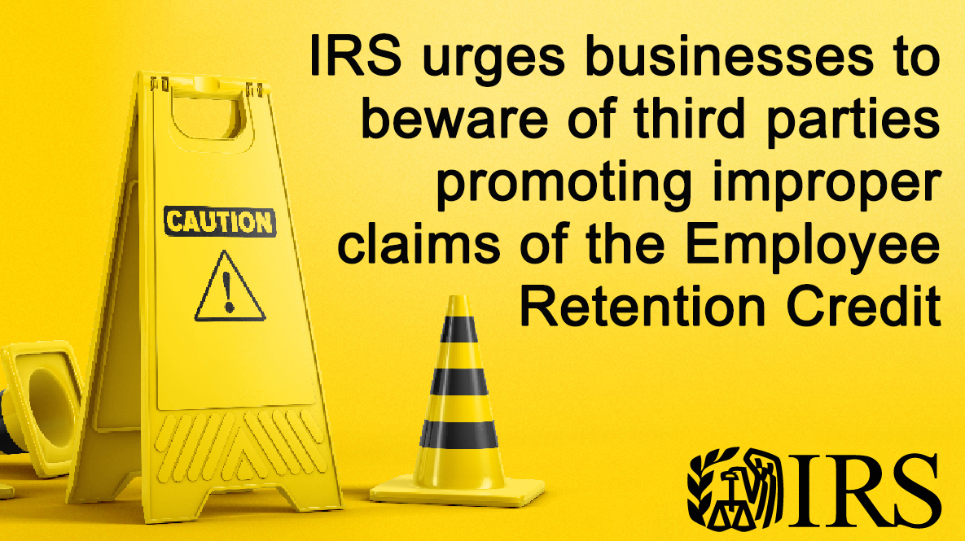
Beware of ERC Schemes
Notes:
I’d like to read a statement from our new Commissioner Danny Werfel warning about the proliferation of Employee Retention Credit scams.
"The aggressive marketing of these credits is deeply troubling and a major concern for the IRS. Businesses need to think twice before filing a claim for these credits. While the credit has provided a financial lifeline to millions of businesses, there are promoters misleading people and businesses into thinking they can claim these credits. There are very specific guidelines around these pandemic-era credits; they are not available to just anyone. People should remember the IRS is actively auditing and conducting criminal investigations related to these false claims. We urge honest taxpayers not to be caught up in these schemes.“
Our Commissioner and the Service overall are concerned that honest taxpayers can be duped by promoters.
In September, the IRS announced a moratorium on processing any new claims that come in. It will be in place at least through the end of the year.
This was a result of concerns not only by IRS, but by tax professionals and the media reporting that many folks were duped into claiming the credit and were ineligible.
Continuing to work the claims that were already in the system, but the processing times will increase since they are looking more closely at each and every claim right now. Processing times will increase to at least 180 days, or it could be much longer if it’s referred for an audit. They may also request additional documentation during processing to ensure it is a legitimate claim.
Hundreds of criminal cases are being worked, and thousands of ERC claims have been referred for audit.

Slide 27
Withdraw an Employee Retention Credit (ERC) claim www.IRS.gov/withdrawmyerc
ERC Voluntary Disclosure Program
  Employee Retention Credit – Voluntary Disclosure Program | Internal Revenue Service (irs.gov)
Notes:
If you have filed ERC claims and later determine you were not eligible….
Withdraw an application that has not been processed yet. Or has been processed but you haven’t deposited or cashed the check.
Refer to IRS.gov/withdrawmyerc
If you have already received the payment but determine you weren’t eligible, you may be eligible for the Voluntary Disclosure Program. You can apply to be part of the program and if accepted, you would only need to pay back 80% of the credit received and there would be no interest or penalties, unless you weren’t able to pay back the full 80% at one time and need an installment agreement.

Slide 28
Communications & Liaison
Stakeholder Liaison
Go to
www.IRS.gov/ERC
for more information, FAQs,
guidance & resources
Notes:
Lots of great resources that will help determine if you’re eligible.
Reminder: Search “ERC Chart” on IRS.gov for the Employee Retention Credit Comparison Chart.

Slide 29
QUESTIONS
Thank you!
Notes:
I’m sorry I ran long…that was certainly a lot of info to cover.
Please feel free to contact me with questions or if you have any feedback…such as if you need additional information that you can’t find on IRS.gov or you can even send your feedback and thoughts about any of the information I presented today.

